Slide 1
Text Chapter 2
Living Things

Slide 2
Section-1: What is Life?
The Characteristics of Living Things
Life Comes From Life
The Needs of Living Things

Slide 3
The Characteristics of Living Things
ALL living things, or organisms, share several important characteristics
They have a cellular organization
They contain similar chemicals
They use energy
They respond to their surroundings
They grow and develop
They reproduce

Slide 4
The Characteristics of Living Things
Cellular Organization
ALL organisms are made of cells
A cell is the extremely small, basic unit of structure and function in an organism
Size of cell

Slide 5
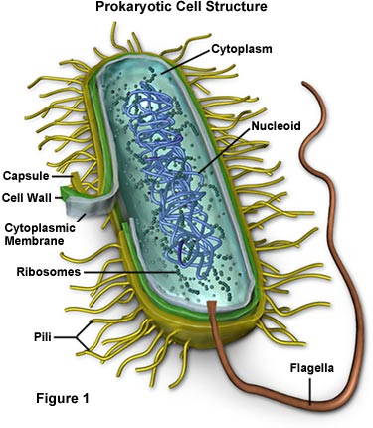
The Characteristics of Living Things
Cellular Organization
Unicellular organisms – are composed of only one cell, e.g. bacteria
Multicellular organisms – are composed of many cells that are specialized in function, e.g. humans have muscle cells, blood cells, nerve cells, etc.

Slide 6
The Characteristics of Living Things
The Chemicals of Life…
The cells of all living things are composed of chemicals
Water
Carbohydrates
Proteins
Lipids
Nucleic acids

Slide 7
The Characteristics of Living Things
Use Energy
The cells of organisms constantly use energy to perform the functions that living things must do.
Move
Repair parts
Reproduce
Conduct nerve impulses

Slide 8
The Characteristics of Living Things
Respond to Surroundings
All organisms respond, or react to changes in their external and/or internal environments (called stimuli {singular is stimulus})
Ex:
Temperature
Light
Sound
Force
Etc.
STIMULUS RESPONSE

Slide 9
The Characteristics of Living Things
Growth and Development
Growth – process of increasing in size
Development – process of change as organism ages and becomes more complex

Slide 10
The Characteristics of Living Things
Reproduction
Organisms can reproduce themselves, that is produce offspring that are identical, or very similar, to the parent organism(s).
Asexual
Sexual

Slide 11
Life Comes From Life
All organisms arise from organisms through the process of reproduction
Spontaneous Generation
Hundreds of years ago, it was believed that living things could arise from non-living sources
Examples:
Flies from rotting meat
Moths from clothing and rags
Mice from grain barrels

Slide 12
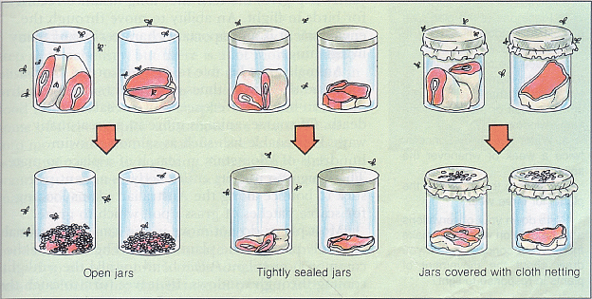
Life Comes From Life
Spontaneous Generation
Francisco Redi’s experiment
In 1668, designed one of the earliest documented controlled experiments. The results rejected the idea of spontaneous generation.

Slide 13
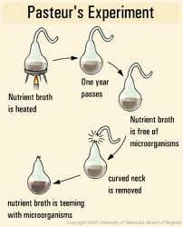
Life Comes From Life
Spontaneous Generation
Louis Pasteur’s Experiment
In 1862, Pasteur designed some controlled experiments that finally rejected spontaneous generation.
He demonstrated that new bacteria will only appear in broth when produced by existing bacteria.

Slide 14
The Needs of Living Things
ALL living things have the same FOUR fundamental needs…
Water
Food
Living space
Stable internal environment

Slide 15
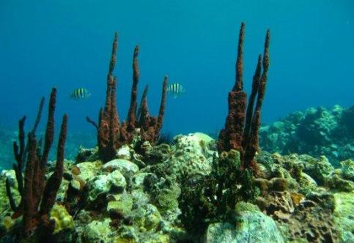
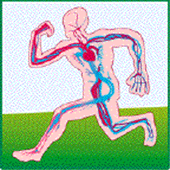
The Needs of Living Things
Need for water…
Obtain chemicals from surroundings (ex: oxygen)
Break down food
Transport substances within their bodies
reproduction

Slide 16
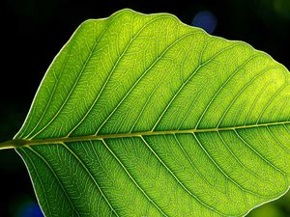
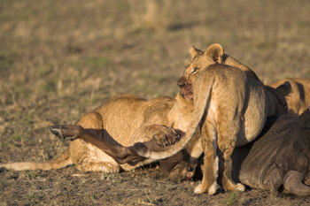
The Needs of Living Things
Need for Food…
Energy source
Autotrophs – organisms that use an external energy source (like the sun) to make their own food (e.g. green plants, and blue-green algae)
Heterotrophs – organisms that cannot make their own food. Heterotrophs consume autotrophs, or consume other heterotrophs that eat autotrophs (e.g. animals, fungi, and slime molds)

Slide 17
The Needs of Living Things
Need for Living Space…
All organisms need a place to live that provides food, water, and shelter
Need for Stable “Internal” Conditions
Homeostasis – ability of organisms to maintain stable conditions inside their bodies (e.g. temperature, oxygen level, & water level), despite the conditions of their surrounding environment.

