Slide 1
Text Chapter 2 (cont’d)
Living Things

Slide 2
Section-2: Classifying Organisms
Why Do Scientists Classify?
The Naming System of Linnaeus
Levels of Classification
Domains and Kingdoms
Domain Eukarya

Slide 3
Why Do Scientists Classify?
Classification
Process of grouping things based on their similarities
Scientists classify living things so that the organisms are easier to study
Taxonomy
The scientific study of how organisms are classified
Involves naming organisms according to how they are classified

Slide 4
The Naming System of Linnaeus
Carolus Linnaeus (1750’s)
Classified organisms according to their observable features (e.g. body parts like # of legs, or wings)
“Binomial Nomenclature”
Each organism was given a unique, two-part scientific name

Slide 5
The Naming System of Linnaeus
Genus
First name – general group of similar organisms
Ex – Canis is the genus that wolves, dingos, and domestic dogs belong to
Species
Second name – for a distinctive feature of each organism
Ex – Canis Domesticus is the genus and species name for all of the breeds of the domestic dog.

Slide 6
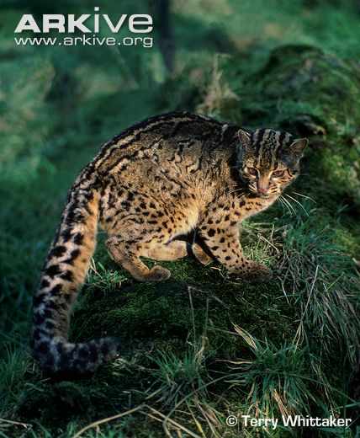
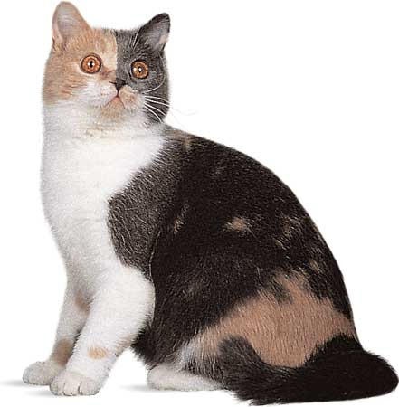
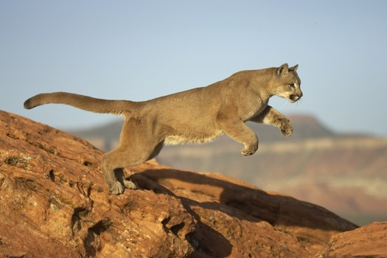
The Naming System of Linnaeus
GENUS
FELIS
CONCOLOR
DOMESTICUS
MARMORATA
SPECIES

Slide 7
Levels of Classification
Domain (highest, largest group)
There are kingdoms within each domain
There are phyla within each kingdom
There are classes within each phylum
There are orders within each class
There are families within each order
There are one or more genera in each family
There are one or more species in each genus
(lowest, smallest level)
How many levels of classification are there?

Slide 8
Levels of Classification
The full classification of humans is the following…
Domain – Eukarya
Kingdom – Animalia
Phylum – Chordata (*sub-phylum – vertebrata)
Class – Mammalia
Order – Primates
Family – Hominidae
Genus – Homo
Species – Sapiens

Slide 9
Domains & Kingdoms
The Three Domains
Domains are separated by cell type
Kingdoms are separated by autotrophs and heterotrophs, and whether they are unicellular or multicellular

Slide 10
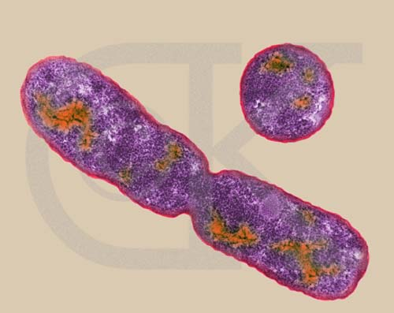
Domains & Kingdoms
Domain - Bacteria (*also called Eubacteria)
Unicellular
Some are autotrophs, some are heterotrophs
Prokaryotes – meaning their cells are called prokaryotic
*No nucleus – nucleic acids not contained in a nucleus
E. Coli bacteria
reproducing

Slide 11
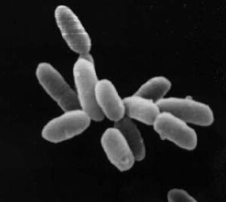
Domains & Kingdoms
Domain - Archaea
Exist in extreme environments – “extremophiles”
Deep-ocean volcanic vents
Volcanic hot springs
Extremely salty water
Guts of cows!
Unicellular
Prokaryotes
Some are autotrophs, some are heterotrophs
*Cells are structurally and chemically different from bacteria

Slide 12
Domain Eukarya
All organisms in this domain are made of eukaryotic cells (thus they are eukaryotes)
All eukaryotic cells have a nucleus which contains its nucleic acids.
Divided into four kingdoms:
Protists
Fungi
Plants
Animals

Slide 13
Domain Eukarya
Protists
Most are unicellular (paramecium, amoeba)
Some are colonial, or large multicellular organisms (seaweed)
Both autotrophic and heterotrophic
Fungi
Most are multicellular (mushrooms, molds, mildews)
Few are unicellular (yeast)
ALL are heterotrophic, and most live on land

Slide 14
Domain Eukarya
Plants
ALL are multicellular, & most live on land
ALL are autotrophic (perform photosynthesis)
*Main food source for the Earth’s heterotrophic organisms
Animals
ALL are multicellular
ALL are heterotrophic

