Slide 1
Text Chapter 2 (cont’d)
Living Things

Slide 2
Section-3: Discovering Cells
An Overview of Cells
First Observations of Cells
Development of the Cell Theory
Light and Electron Microscopes

Slide 3
(2-3) An Overview of Cells
*Recall that cells provide the following to an organism
Structure
Determined by variety of ways that cells are put together
Function
Cells perform the same functions as whole organisms need to: absorbing oxygen, eliminating wastes, absorbing food, etc.

Slide 4
(2-3) First Observation of Cells
The first light microscope was invented in 1590
Compound: two lenses

Slide 5
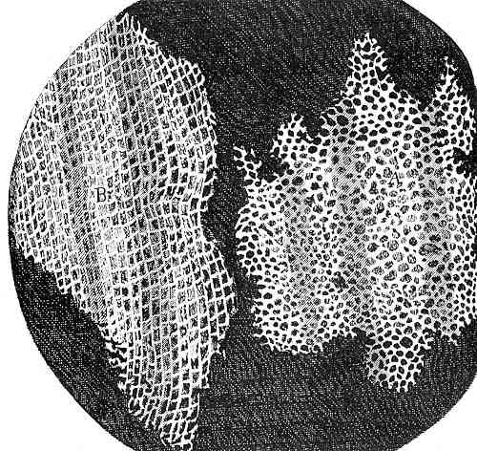
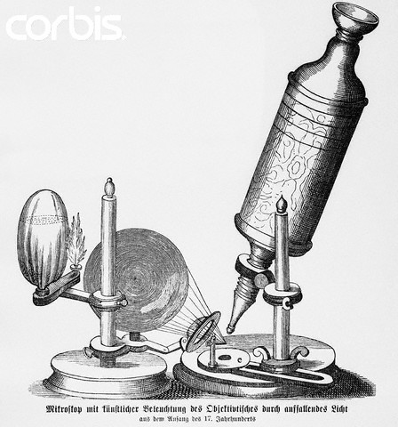
(2-3) First Observation of Cells
Robert Hooke was the first to use a microscope to observe the cells in a thin slice of cork (1663)
Coined the use of the term “cell,” to mean a “small room”

Slide 6
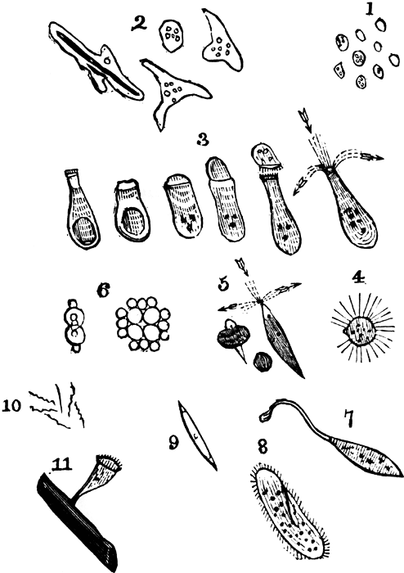
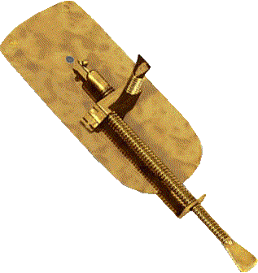
(2-3) First Observation of Cells
Anton van Leeuwenhoek was the first to use a microscope to observe single-celled organisms living in lake water (1674)
Van Leeuwenhoek’s simple microscope

Slide 7
(2-3) Development of Cell Theory
Matthias Schleiden
1838 concluded all plants are made of cells
Theodor Schwann
1839 concluded all animals are made of cells
Hypothesized that ALL living things are made of cells
Rudolf Virchow
Proposed that new cells can only come from pre-existing cells
Rejected notion of “spontaneous generation”

Slide 8
(2-3) Development of Cell Theory
Cell Theory
All living things are composed of cells
Cells are the basic unit of structure & function in living things
All cells are produced from other cells

Slide 9
(2-4) Light &Electron Microscopes
Simple light microscopes
Single lens
limited magnification
Compound light microscopes
Two or more lenses, therefore greater magnification
Electron microscopes
View objects much smaller than wavelengths of light
e.g. Bacteria, viruses
Scanning-Tunneling electron microscopes
View some of the smallest objects: Molecules & atoms
*Light microscopes can only magnify objects larger than the wavelengths of light (≈400-800 nm)

Slide 10
Section-4: Inside Cells
Enter the Cell
Sail on to the Nucleus
Organelles in the Cytoplasm
Specialized Cells

Slide 11
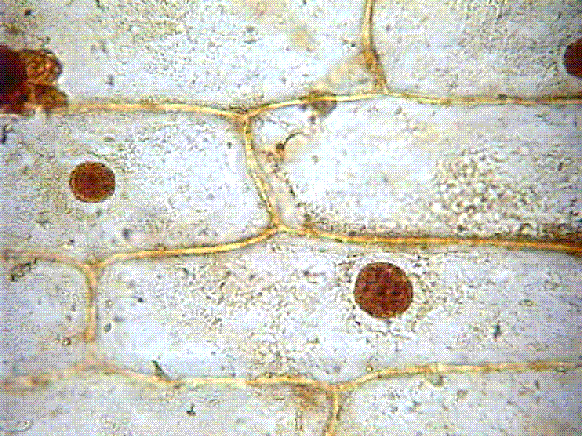
Enter the Cell
Cell Wall
Strong outer layer of plant cells
Inorganic (non-living) material: cellulose
Protects and supports cell, gives it shape
Cell wall

Slide 12
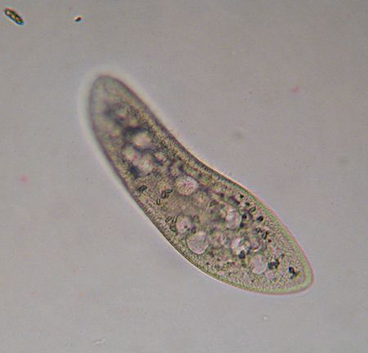
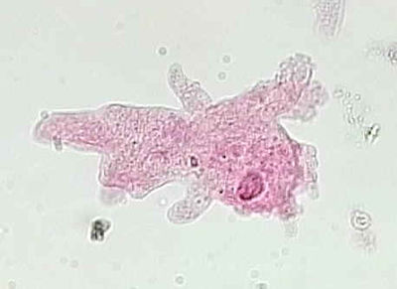
Enter the Cell
Cell Membrane
Found in ALL cells
In cells with cell walls: located just inside the cell wall
In other cells, it is the outside boundary of the cell
Controls what enters and exits the cell
Cell membrane

Slide 13
Sail on to the Nucleus
The nucleus acts as the cell’s control center, directing all of the cell’s activities.
There are three distinctive parts to the nucleus
Nuclear envelope
Porous outer membrane of nucleus
Materials pass in and out of the nucleus
Chromatin
Long, thin strands of nucleic acids: genetic material of cell
Nucleolus
Small, dense structure where ribosomes are made

Slide 14
Sail on to the Nucleus

Slide 15
Organelles in the Cytoplasm
Cytoplasm is a clear, thick, gel-like fluid contained within the cell membrane.
It is composed mostly of water.
There are many other small structures floating and moving around in the cytoplasm: called organelles

Slide 16
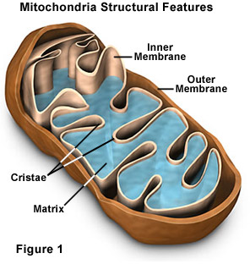
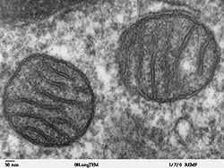
Organelles in the Cytoplasm
Mitochondria
Rod-shaped structures that convert the chemical energy in food molecules to energy the cell can use for its functions
The cell’s “powerhouses.”

Slide 17
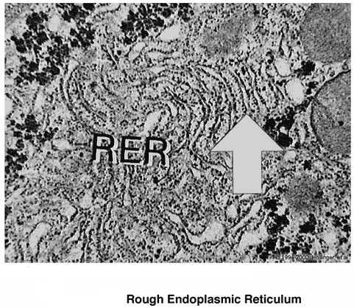
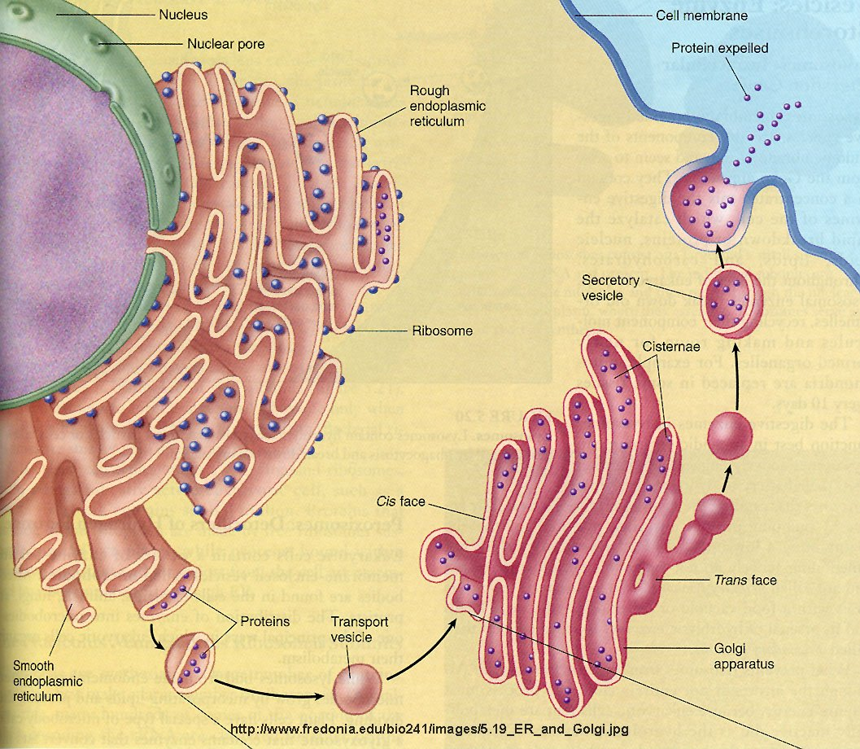
Organelles in the Cytoplasm
Endoplasmic Reticulum (E.R.)
Maze-like structure with “passageways”
Transports proteins and other materials throughout cell

Slide 18
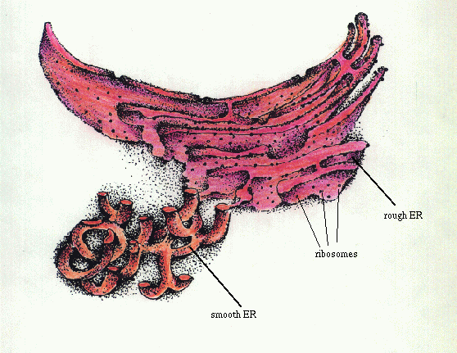
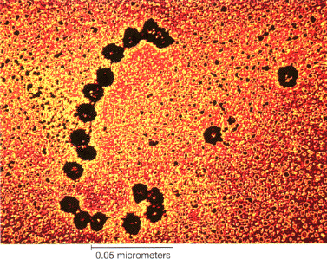
Organelles in the Cytoplasm
Ribosomes
Small, grain-like structures that produce proteins
Cell’s “factories”
Found on parts of endoplasmic reticulum, and floating in cytoplasm

Slide 19
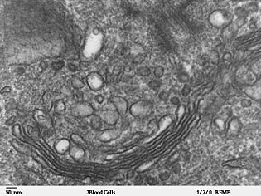
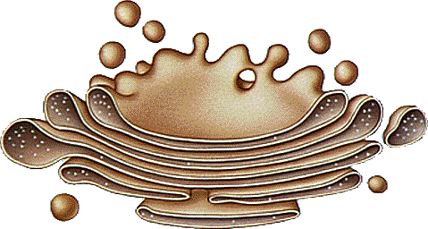
Organelles in the Cytoplasm
Golgi Bodies
Flattened, tube-like structure
Receives proteins & other materials from the E.R., then distributes to other parts of the cell, or releases materials out of the cell: the cell’s “mail room”

Slide 20
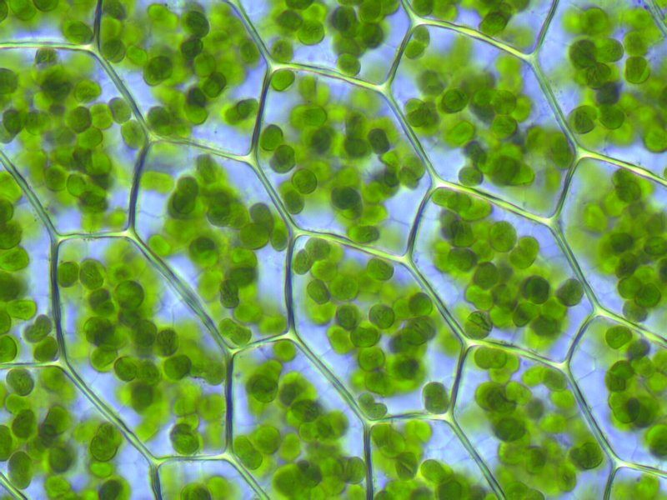
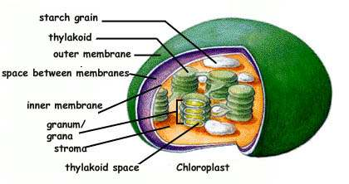
Organelles in the Cytoplasm
Chloroplasts
Large, green structures floating in cytoplasm of plant cells, and some autotrophic bacteria
Converts energy from sunlight and uses it to make food for the cell (photosynthesis)

Slide 21
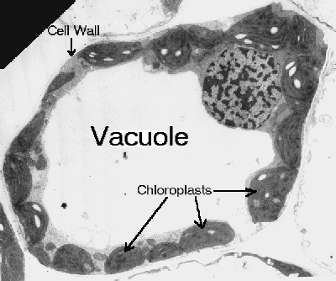
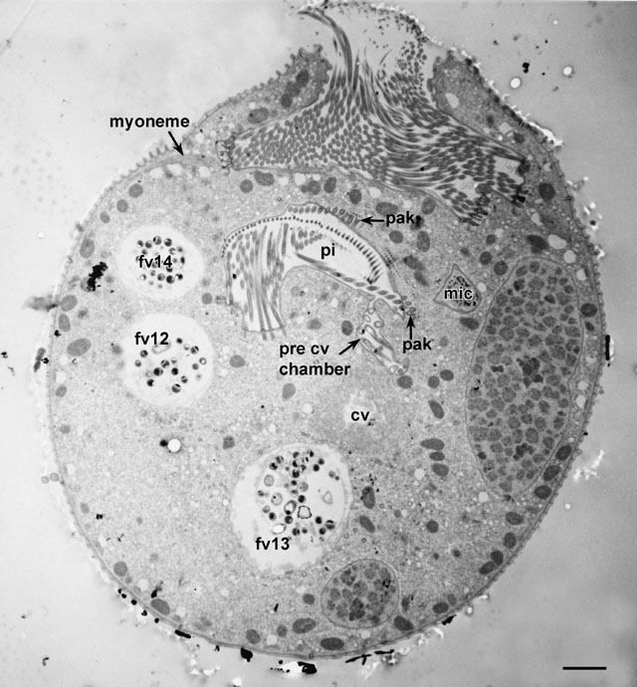
Organelles in the Cytoplasm
Vacuoles
Sac-like structures floating in the cytoplasm
Storage areas: e.g. water, food, waste products
*Notice that plant cells often have ONE large vacuole

Slide 22
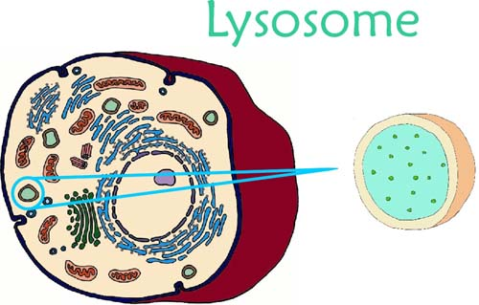
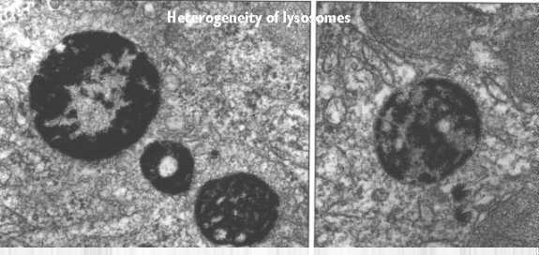
Organelles in the Cytoplasm
Lysosomes
Small, round structures usually found in vacuoles
Contain chemicals that break down certain materials:
Food particles
Old cell parts
The cell’s “clean-up crew”

Slide 23
Specialized Cells
In most large, multi-cellular organisms…
There are specialized cells for performing specific functions (e.g. nerve cells, blood cells)
Cells are organized into
Organ systems
Organs
Tissues
cells

