Slide 1
(3-1) Chemical Compounds in Cells
Elements and Compounds
Carbohydrates
Lipids
Proteins
Nucleic Acids

Slide 2
Elements & Compounds
Let’s Review…
Element
Any substance that cannot be reduced into simpler substances
The smallest unit of an element is the atom
Ex: oxygen (O), hydrogen (H), carbon (C), silicon (Si)

Slide 3
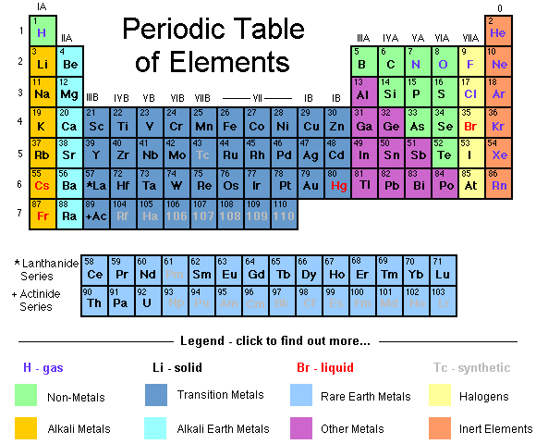
Elements & Compounds
Recall the Periodic Table of the Elements
BTW… this is a classification system, or “taxonomy” for the elements

Slide 4
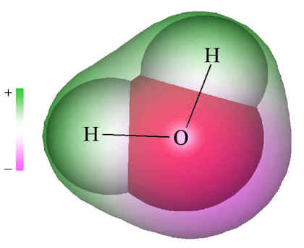
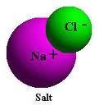
Elements & Compounds
Let’s Review…(cont’d)
Compound
Substance formed by two or more elements that combine chemically
New substance has different properties than the elements that it’s composed of
Ex: water (H₂O), salt (NaCl), ammonia (NH₃), carbon dioxide (CO₂)

Slide 5
Elements & Compounds
Organic vs. Inorganic Compounds
Organic compounds
Made of molecules that have a carbon atom
Ex: methane (CH₄), glucose (C₆H₁₂O₆)
Inorganic compounds
Made of molecules that do not have carbon
Ex: water (H₂O), salt (NaCl)
Carbohydrates, lipids, proteins, & nucleic acids are ALL important groups of organic compounds in cells

Slide 6
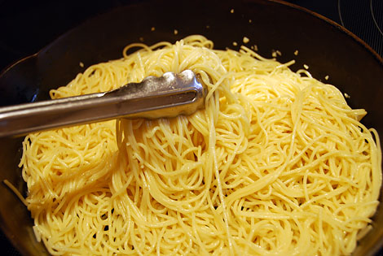
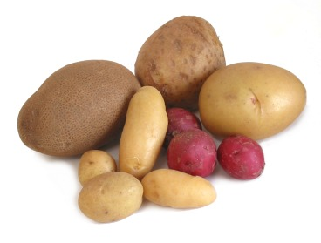
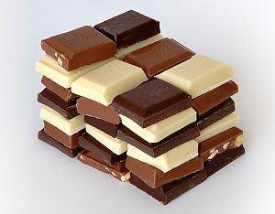
Carbohydrates
Energy-rich compound composed of carbon, hydrogen, and oxygen
Sugars and starches are both carbohydrates
Make up the cell walls of plants, and part of the cell membrane

Slide 7
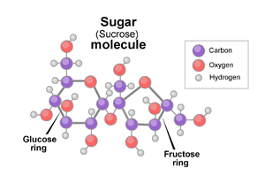
Carbohydrates

Slide 8
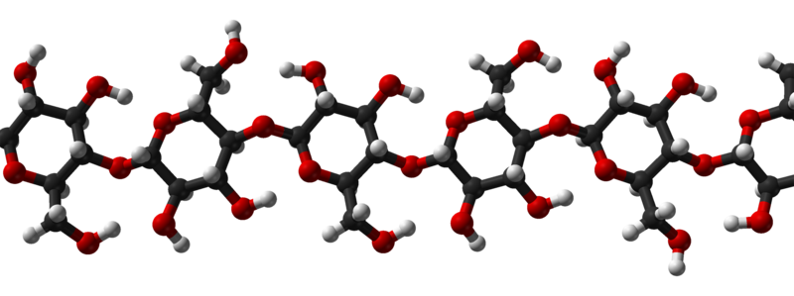
Carbohydrates
Cellulose molecule
Sugar molecules form the “rings” in the chain

Slide 9
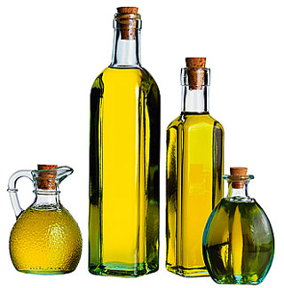
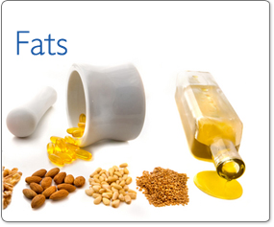
Lipids
Another energy-rich compound made up of carbon, hydrogen, and oxygen (more so than carbohydrates)
Fats, oils, and waxes are ALL lipids
Main component of cell membranes

Slide 10
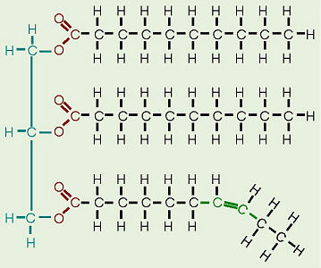
Lipids
Fatty acids

Slide 11
Proteins
Large organic molecules composed of smaller molecules called amino acids
There are only about 20 common amino acids… BUT they can combine to form MILLIONS of different proteins
Analogy: How many words can be generated by the 26 letters of the alphabet?
Amino acids are composed of the elements carbon (C), hydrogen (H), oxygen (O), nitrogen (N), and in some cases sulfur (S)

Slide 12
Proteins
Foods that are high in protein are:
Meat, eggs, fish, nuts, and beans
Make up part of the cell membrane, and most of the cell’s organelles
Enzymes
Protein that speeds up chemical reactions
Found in saliva and digestive “juice” of stomach

Slide 13
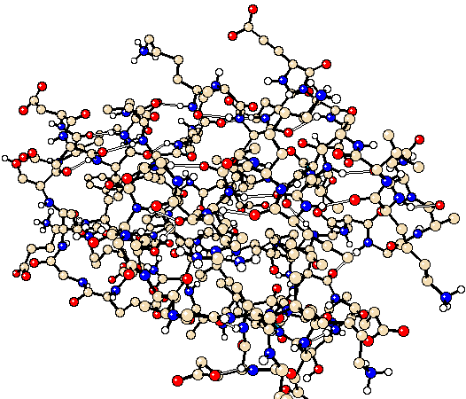
Proteins
Model of a typical protein molecule

Slide 14
Nucleic Acids
Extremely long organic molecules made of carbon (C), oxygen (O), hydrogen (H), nitrogen (N), and phosphorous (P) atoms
Two major types:
Deoxyribonucleic acid (DNA)
Genetic material passed from parent to offspring
Located in chromatin of nucleus
Ribonucleic acid (RNA)
Necessary for protein production
Located in both nucleus and cytoplasm

Slide 15
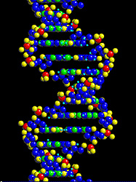
Nucleic Acids
Portion of a DNA molecule

