Slide 1
(3-5) Cell Division
Stage 1: Interphase
Stage 2: Mitosis
Stage 3: Cytokinesis
Structure and Replication of DNA

Slide 2
The “Cell Cycle”
There are three main stages in the life cycle of a cell…
Stage 1: Interphase
Stage 2: Mitosis
Stage 3: Cytokinesis

Slide 3
Stage 1: Interphase
The period in the cell cycle before cell division
Cell growth occurs
New ribosomes and enzymes are made
Copies of mitochondria and chloroplasts are made
DNA replication occurs
An exact copy of the DNA in the nucleus is made
Preparation for division
Cell produces structures that are specifically used to divide into two “daughter cells”

Slide 4
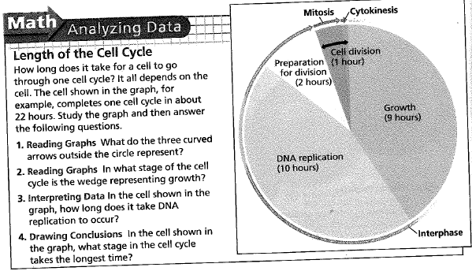
Stage 1: Interphase

Slide 5
Stage 2: Mitosis
Once interphase is complete, the cell is ready to divide, then…
Mitosis occurs in which the cell’s nucleus divides into two new nuclei
One copy of the cell’s DNA is distributed to each daughter cell

Slide 6
Stage 2: Mitosis
Mitosis occurs in four distinct phases:
1st – Prophase
2nd – Metaphase
3rd – Anaphase
4th - Telophase

Slide 7
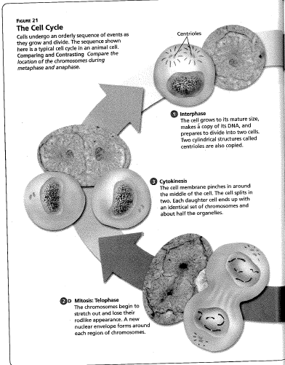
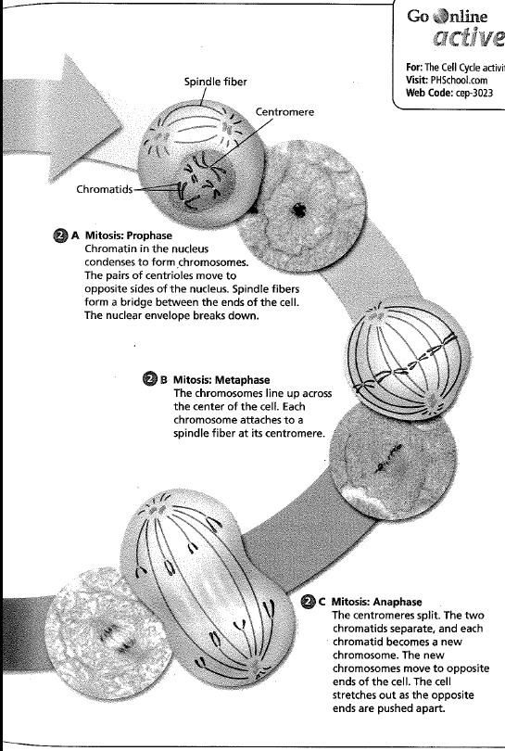
Stage 2: Mitosis

Slide 8
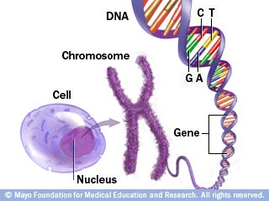
Stage 2: Mitosis
During prophase, the chromatin (DNA) in the nucleus condenses to form double-rod like structures called chromosomes.
Each rod is an exact copy of the other, and is called a chromatid.
The chromatids are held together by a structure called a centromere.
chromatid
chromatid
centromere

Slide 9
Stage 3: Cytokinesis
Cytokinesis
Completes cell division
The cytoplasm divides
Organelles are distributed to each of the two new daughter cells
Slightly different in plant and animal cells

Slide 10
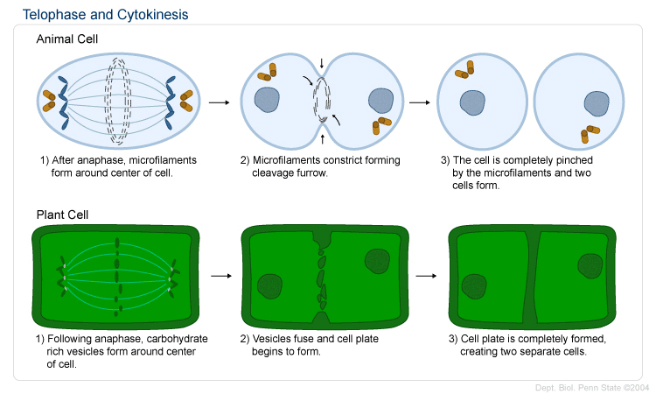
Stage 3: Cytokinesis
Plant cell vs. animal cell cytokinesis

Slide 11
Structure & Replication of DNA
How was the structure of DNA discovered?
Rosalind Franklin (1952)
First successful images of DNA using x-ray crystallography
James Watson & Francis Crick (1953)
Used Franklin’s images to build the first correct model of the DNA molecule
Discovered the “double-helix” shape of the molecule
Won Nobel Prize

Slide 12
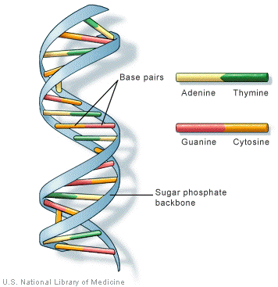
Structure & Replication of DNA
Molecule is shaped like a twisted ladder (“double helix”)
Nitrogen
A
T
G
C
Deoxyribose is the sugar which alternates with phosphates

Slide 13
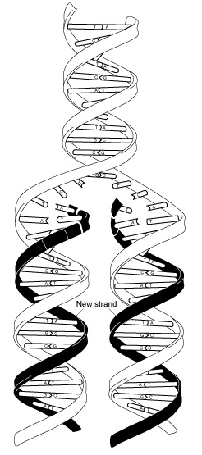
Structure & Replication of DNA
DNA replicates by “unzipping” itself.
The now unmatched nitrogen base pairs become matched up with loose base pairs found distributed throughout the nucleus.

