Slide 1
Genetics: The Science of Heredity
Text chapter 4
Mendel’s work
Probability & heredity
The cell & inheritance
The dna connection

Slide 2
The Cell & Inheritance
Chapter 4, Section 3

Slide 3
Chromosomes & Inheritance
Mendel’s experiments showed that genes exist
However, scientists at that time didn’t know what structures in the cell contained genes
Walter Sutton (1903) hypothesized chromosomes were the key to inherited traits
In studying grasshoppers, he observed that while normal grasshopper cells have 24 chromosomes, grasshopper sex cells (sperm & egg) have only 12 chromosomes.

Slide 4
Chromosomes & Inheritance
He further observed…
That when a grasshopper sperm cell fertilizes a grasshopper egg cell, the newly fertilized egg has 24 chromosomes, the same number as the normal cells in each parent
He concluded…
The 24 chromosomes existed in each grasshopper in 12 pairs
One chromosome in each pair came from the male parent, and the other from the female parent
Paired alleles are carried on paired chromosomes

Slide 5
Chromosomes & Inheritance
The Chromosome Theory of Inheritance
Genes are carried from parents to their offspring on chromosomes.

Slide 6
Meiosis
Meiosis
Process by which chromosome pairs separate and are distributed to two different cells
The resulting “sex” cells (sperm & egg) have only half the number of chromosomes as those in normal cells
Each sex cell has one chromosome from each original pair
Each chromosome in each sex cell has one allele from each original pair

Slide 7
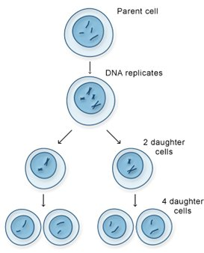
Meiosis
Meiosis I
“Reduction” stage where the chromosomes are divided amongst two daughter cells
Meiosis II
“Mitosis” stage where the two daughter cells simply replicate themselves to produce four daughter cells

Slide 8
Meiosis
Another look at Punnett Squares…
Tt
Male Parent
Possible sperm cells
T
t
Possible egg cells
TT
Tt
T
Female Parent
Tt
t
Tt
tt
The Punnett square shows the possible allele combinations in the fertilized cell

Slide 9
A Lineup of Genes
The body cells of humans contain 46 chromosomes, composed of 23 pairs
One chromosome in the pair comes from the female parent, and the other from the male parent
Chromosomes are made up of many genes (20,000 ~ 25,000) joined together like beads on a string

Slide 10
A Lineup of Genes
Each chromosome in a pair has the same genes
The genes are lined up in the same order on both chromosomes
The alleles for some of the genes might be different.
Which genes are homozygous?
Which genes are heterozygous?
A
a
b
B
C
C
D
d
e
e
F
F
G
g
h
H

Slide 11
The DNA Connection
Chapter 4, Section 4

Slide 12
The Genetic Code
Genes
Recall…
Chromosomes are found in the nucleus of a cell
Chromosomes are composed of tightly coiled DNA
DNA is made up of four nitrogen bases that form the “rungs “ of the DNA “ladder”
Adenine (A), thymine (T), guanine (G), & cytosine (C)
A gene is a section of the DNA molecule that contains information to code for one specific protein
*Proteins help determine size, shape, color, & many other traits

Slide 13
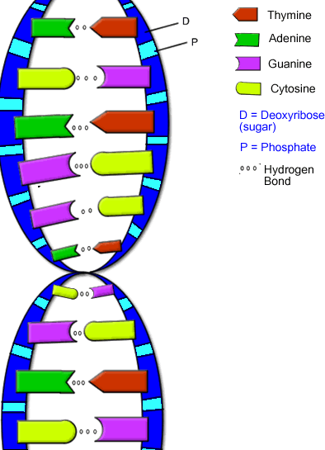
The Genetic Code
Genes
Made up of a series of nitrogen bases in a row
Ex: ATGACGTAC
A single gene may contain anywhere from several hundred to a million or more bases

Slide 14
The Genetic Code
Genes cont’d.
The order of the nitrogen bases along a gene forms a genetic code that specifies the type of protein produced
A group of three bases codes for one specific amino acid
Ex: CGT codes for alanine
The order of the three-base code units determines the order in which amino acids string together to make a protein

Slide 15
How Cells Make Proteins
Even though chromosomes are located in the nucleus of the cell, protein synthesis occurs in the ribosomes
Recall… ribosomes are the small, poppy-seed like structures located throughout the cytoplasm
Role of RNA
It’s main function is to carry the information coded on DNA inside the nucleus out into the cytoplasm

Slide 16
How Cells Make Proteins
RNA vs. DNA
DNA has two strands, RNA has one
DNA and RNA have different sugar molecules as the “sides of the ladder”
DNA has A, G, C, and T as the “rungs of the ladder”, while RNA has A, G, C, and U (uracil)

Slide 17
How Cells Make Proteins
Types of RNA
Messenger RNA
Copies coded message from DNA in nucleus and carries to the ribosome in the cytoplasm
Transfer RNA
Carries amino acids to the ribosome and adds them on to the growing protein

Slide 18
Mutations
What is a mutation?
Any change in a gene or chromosome
What can a mutation do?
Can cause a cell to synthesize an incorrect protein
The result can be a difference in the organism’s phenotype from what is normal
*Mutations in body cells cann0t be inherited by offspring, however, mutations in sex cells can!

Slide 19
Mutations
Types of mutations
When a single nitrogen base gets substituted for another
When one or more nitrogen bases gets removed from a section of DNA, usually during replication
When chromosomes don’t separate properly during meiosis
When cell gains extra segments of chromosomes

Slide 20
Mutations
Effects of mutations
Can be a source of genetic variety
Can be harmful to organism
Depends in part on environment
Can be helpful to organism
E.g. antibiotic resistance in bacteria
Can be neutral – neither helpful nor harmful

