Slide 1
Bones, muscles, and skin
Chapter 14
Body Organization & Homeostasis
The Skeletal System
The Muscular System
The Skin

Slide 2
Body organization & homeostasis
Section 1
Cells
Tissues
Organs & Organ Systems
Homeostasis

Slide 3
Body organization & homeostasis
Cells
Tissues

Slide 4
Body organization & homeostasis
Organs & Organ Systems

Slide 5
Body organization & homeostasis
Homeostasis

Slide 6
Body organization & homeostasis
Homeostasis

Slide 7
The Skeletal system
Section 2
What the Skeletal System Does
Joints of the Skeleton
Bones – Strong and Living
Taking Care of Your Bones

Slide 8
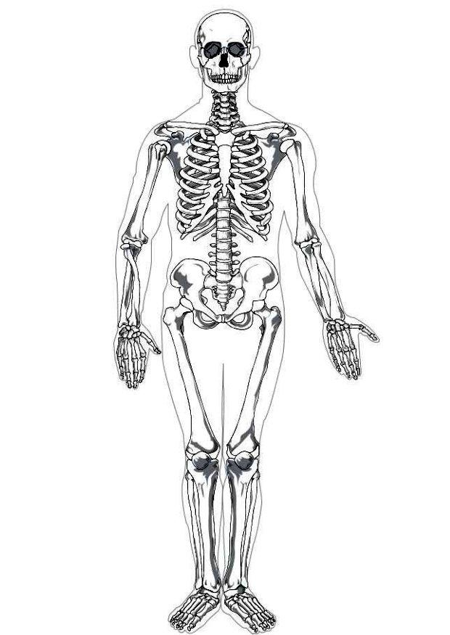
The skeletal System
The Skeleton
Framework of the human body that is composed of all its bones
275 in newborn, 206 in an adult

Slide 9
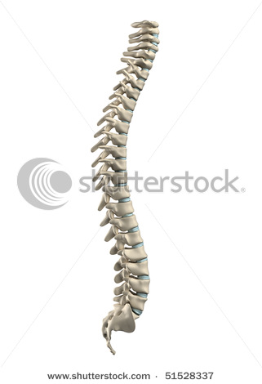
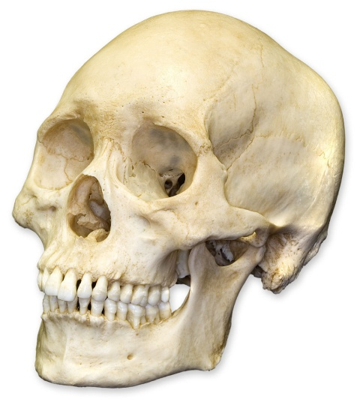
The skeletal System
What the Skeletal System Does
Provides shape and support
Vertebrae (backbone) is center of skeleton
Protects organs
Skull, breastbone, and ribs
Enables movement
Produces blood cells
Stores minerals & other materials

Slide 10
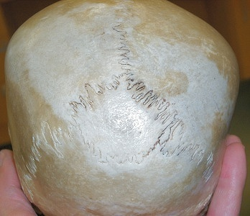
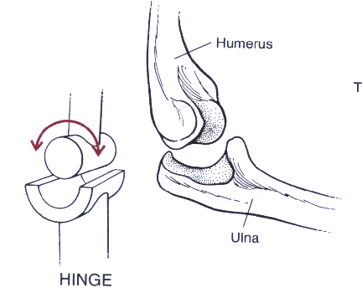
The skeletal System
Joints of the Skeleton
Immovable Joints
Skull
Movable Joints
Hinge Joint
Knee and elbow
Ball-and-Socket Joint
Shoulder and hip
Pivot Joint
Neck
Gliding Joint
Wrist and ankle

Slide 11
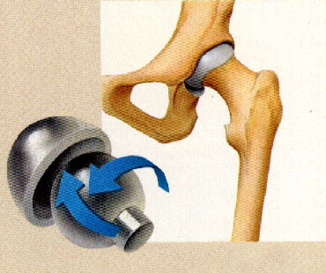
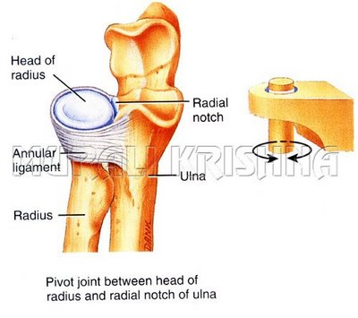
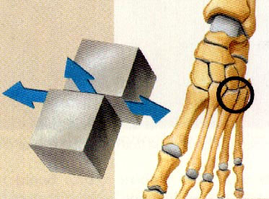
The skeletal System
Joints of the Skeleton
Ball & Socket Joint
Pivot Joint
Gliding Joint

Slide 12
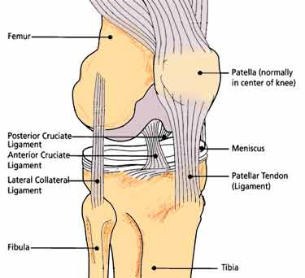
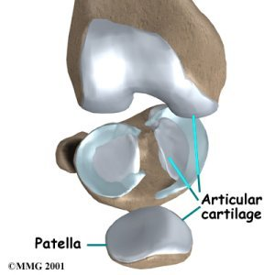
The skeletal System
Joints of the Skeleton
Connective Tissues
Ligaments
Holds joints together
Cartilage
Cushioning
Synovial fluid
Lubrication

Slide 13
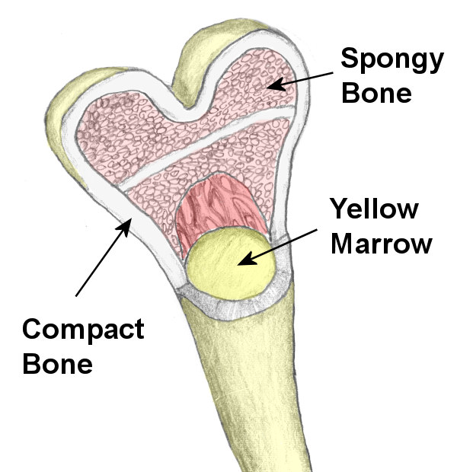
The skeletal System
Bones – Strong and Living
Thin, hard, outer membrane
Compact bone
spongy bone
Marrow
Red
Yellow

Slide 14
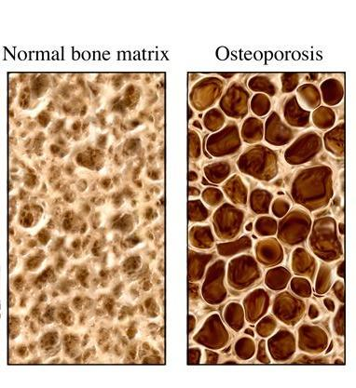
The skeletal System
Taking Care of Your Bones
Balanced diet
Regular exercise
Wear appropriate safety equipment during physical activity
Osteoporosis

Slide 15
The muscular system
Section 3
Types of Muscle
Muscles at Work

Slide 16
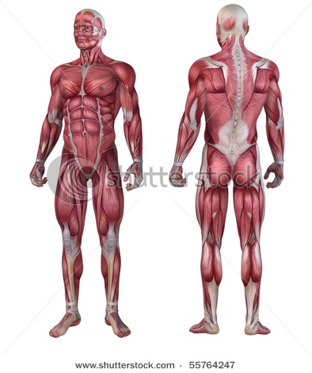
The muscular system
What is the Muscular System
All of the muscles in the body (≈600 in total)
Responsible for all movement
Types of Muscle
Voluntary Muscle
Skeletal muscle
Involuntary Muscle
Smooth & cardiac muscle

Slide 17
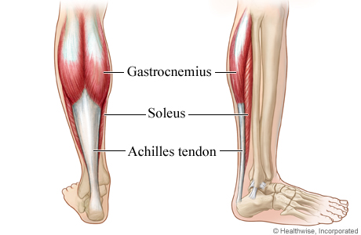
The muscular system
Skeletal Muscle
Attached to the bones of the body
Provides force that moves the bones
Tendons at each end of muscle attach it to the bones
React quickly to conscious thought, but tire quickly

Slide 18
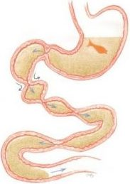
The muscular system
Smooth Muscle
Line many internal organs
Aid in digestion
Esophagus, stomach
Aid in blood flow
arteries
Slow to react but tires slowly

Slide 19
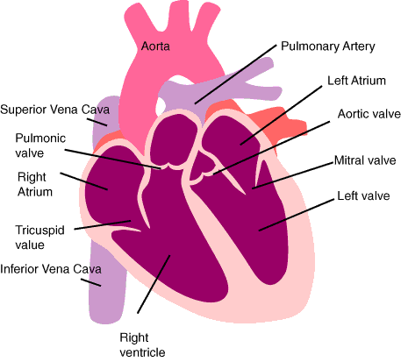
The muscular system
Cardiac Muscle
Located only in the heart
Never tire
Repeated contractions cause “heartbeats”

Slide 20
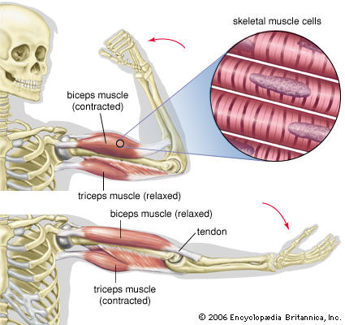
The muscular system
Skeletal Muscles at Work
They can only contract, not extend
Must work in pairs to provide range of motion
While one contracts, the other relaxes
Ex: biceps and triceps

Slide 21
The skin
Section 4
The Body’s Tough Covering
The Epidermis
The Dermis
Caring for Your Skin

Slide 22
The skin
The Body’s Tough Covering
Largest single organ of the human body
S.A. ≈ 1.5 m²
Performs five major functions
(1) Protects body from…
Injury – tough, protective outer cover
Infection – barrier against viruses & bacteria
Water loss – seals body against drying out

Slide 23
The skin
The Body’s Tough Covering (cont’d…)
Performs five major functions
(2) Regulates body temperature
When body temp becomes too high…
Blood vessels expand to increase blood flow, conduct heat away
Sweat glands in skin cause perspiration
(3) Eliminates wastes
Sweat glands also release dissolved waste in perspiration
Broken down proteins

Slide 24
The skin
The Body’s Tough Covering (cont’d…)
Performs five major functions
(4) Gathers information about external environment
Nerves in skin provide information about…
Pressure, pain, & temperature
(5) Produces vitamin D
Some skin cells produce vitamin D in the presence of sunlight
Important for healthy bones

Slide 25
The skin
There are two main layers of skin…
(1) The Epidermis
Thin, outermost layer of skin
No nerves or blood vessels
Structure
Cells form deep in layer and move toward surface where they die and remain for a few weeks
Function
Dead, outer cells provide protection
Deeper cells produce the pigment, melanin

Slide 26
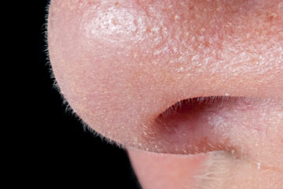
The skin
(2) The Dermis
Inner layer of skin, below epidermis and above fat layer (padding & insulation to protect internal organs)
Contains nerves, blood vessels, sweat glands, hairs, and oil glands
Perspiration from sweat glands reaches surface through pores
Hair grows in dermis from structures called follicles

Slide 27
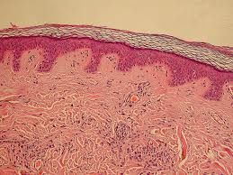
The skin
Upper Epidermis
(dead cells)
Lower Epidermis
Dermis

Slide 28
The skin
Caring for Your Skin
Three simple habits to keep skin healthy…
Healthy Diet
Include enough H₂O to replace lost water
Keeping Skin Clean
Removes dirt & harmful bacteria
Controls oiliness (*particularly during adolescence)
Limiting Sun Exposure
Can make skin leathery and wrinkled
Can damage skin cells & possibly lead to *cancer (*uncontrolled growth of certain cells in body)

Slide 29
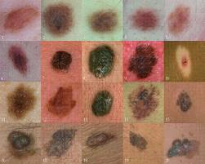
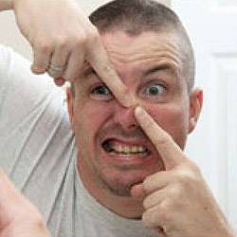
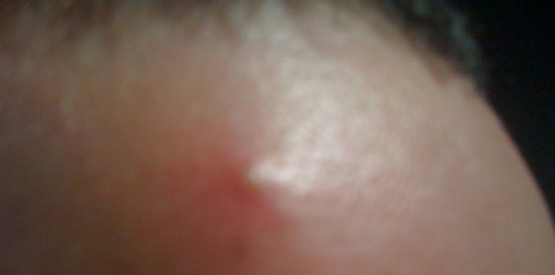
The skin

