Slide 1
Food & Digestion
Text Chapter 15
Section 1 – Food & Energy
Section 2 – The Digestive Process Begins
Section 3 – Final Digestion & Absorption

Slide 2
Food & Energy
Section 1
Why You Need Food
Carbohydrates
Fats
Proteins
Vitamins & Minerals
Water
Guidelines for a Healthy Diet
Food Labels

Slide 3
Why You Need Food
Your body breaks down the food you eat into nutrients
These provide your body with the materials necessary for growth, repair and energy for all of your life processes, including homeostasis

Slide 4
Why You Need Food
Nutrients
There are six main groups necessary for human health…
Carbohydrates
Fats
Proteins
Vitamins
Minerals
Water

Slide 5
Why You Need Food
Energy
The energy released by nutrients during cellular respiration is measured in calories (English system)
Recall…
Food + oxygen → energy + waste CO₂ + waste H₂O
-OR-
C₆H₁₂O₆ + 6O₂ → energy + 6CO₂ + 6H₂O

Slide 6
Why You Need Food
Energy (cont’d)
1 calorie = energy needed to raise temp. of 1 gram of H₂O by 1º Celsius
In Biology… 1 Calorie (*w/a capital C) = 1 kilocalorie = 1000 calories of energy
The more active you are, the greater your energy needs are

Slide 7
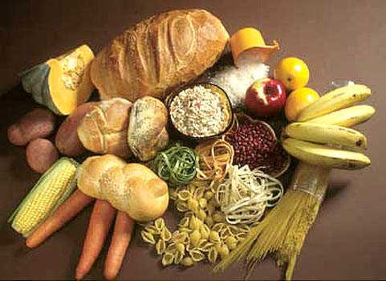
Carbohydrates
Nutrient that serves as a major source of energy
Depending on chemical structure can be classified as either:
Simple Carbohydrates
Sugars – fruits, etc.
Complex Carbohydrates
Starches – potatoes, rice, corn, etc.
Nutritionists’ Recommendations
45% to 65% of Calories from carbohydrates

Slide 8
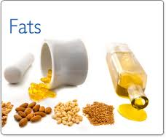
Fats
Energy rich nutrient (more than twice that of carbohydrates)
Form part of cell membrane
Provide protective padding and insulation

Slide 9
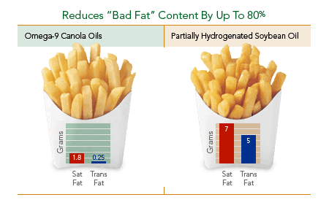
Fats
Kinds of Fats
Unsaturated
Saturated
Trans fats
Cholesterol
Liver manufactures whatever your body needs
Nutritionists’ Recommendations
No more than 30% of daily Calories

Slide 10
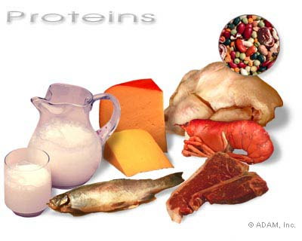
Proteins
Required for tissue growth and repair
Form enzymes which speed up chemical reactions within cells
Can serve as energy source, but less so than carbohydrates and fats

Slide 11
Proteins
Amino Acids
Body can only make ½ of amino acids it needs
Rest must come from food
Complete vs. Incomplete Proteins
“Complete” proteins contain all essential amino acids
Animal products: meat, eggs, etc.
“Incomplete” proteins are missing at least one essential amino acid
Plant products: beans, grains, nuts, etc.

Slide 12
Vitamins & Minerals
Required only in small quantities
Do not provide energy or raw materials
Aid the body in carrying out important chemical processes
Clotting blood
Hardening bones
Healing wounds

Slide 13
Water
The most important nutrient
Cells are mostly water
Vital chemical reactions take place in water

Slide 14
The Digestive Process Begins
Section 2
Functions of the Digestive System
The Mouth
The Esophagus
The Stomach

Slide 15
Functions of the Digestive System
The digestive system has three main functions:
Digestion
Body breaks down food into small nutrient molecules both mechanically and chemically
Mechanical digestion physically breaks food down into smaller pieces
Chemical digestion uses body chemicals to dissolve and break down food into simpler molecules

Slide 16
Functions of the Digestive System
The digestive system has three main functions:
Absorption
Nutrient molecules are passed through the wall of the digestive system into the blood to be transported to every cell in the body
Elimination
Materials that are not absorbed are eliminated from the body as waste

Slide 17
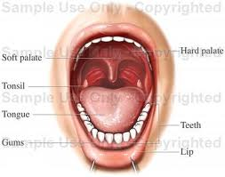
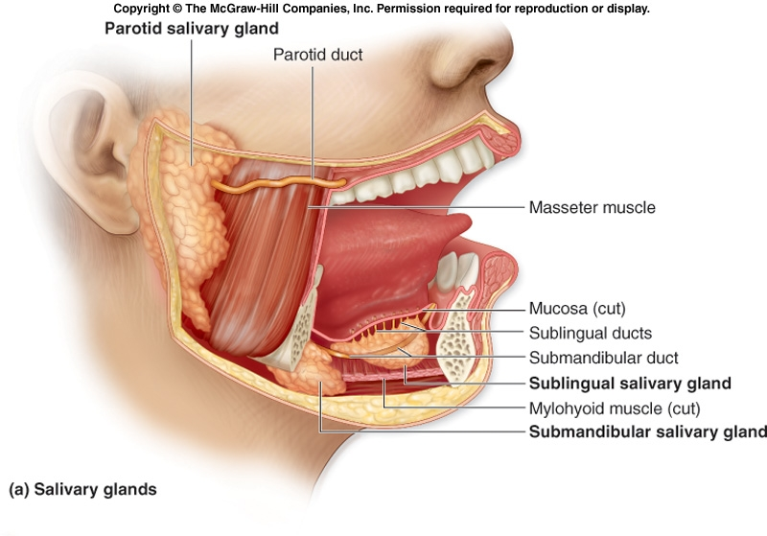
The Mouth
The mouth performs both mechanical and chemical digestion

Slide 18
The Mouth
Mechanical Digestion in Mouth
Incisor teeth cut food into mouth-sized pieces
Canine teeth tear food into even smaller pieces
Molar teeth crush and grind food
Saliva moistens and softens food

Slide 19
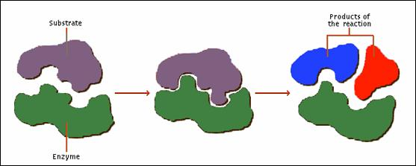
The Mouth
Chemical Digestion in Mouth
Enzymes in saliva begin to break down complex carbohydrates, like starch
STARCH
SUGAR-A
SUGAR-B

Slide 20
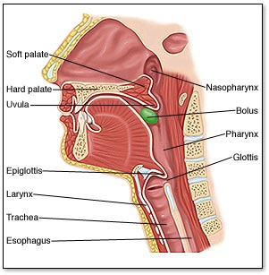
The Esophagus
Mucus-lined tube that transports partially-digested food from mouth to stomach

Slide 21
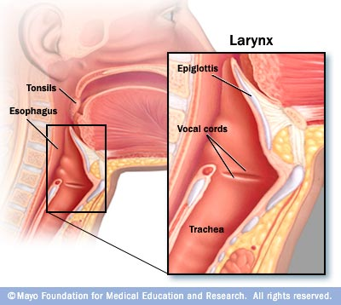
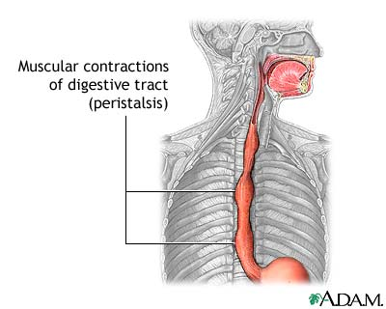
The Esophagus
Epiglottis
Flap that seals off trachea (air tube), so that food can pass down into the esophagus (food tube)
Peristalsis
Rhythmic contractions of smooth muscle that force food in one direction toward stomach

Slide 22
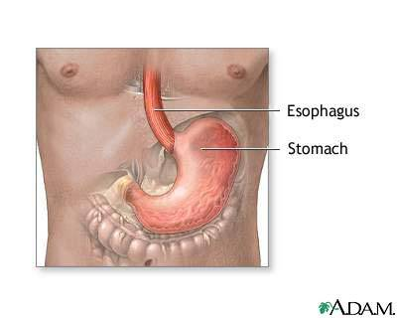
The Stomach
When partially digested food leaves the esophagus, it enters the stomach, which expands to hold the food
Most mechanical digestion, and some chemical digestion occur in the stomach

Slide 23
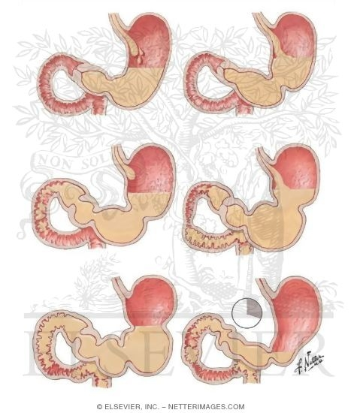
The Stomach
Mechanical Digestion
Strong layers of smooth muscles churn the food to mix it with digestive fluids

Slide 24
The Stomach
Chemical Digestion
Pepsin
Enzyme that breaks proteins down into amino acids
Hydrochloric acid
Kills bacteria consumed along with food
Dissolves food further
Improves pepsin’s effectiveness
Chyme
Thick liquid formed by digestion of food in stomach

Slide 25
Final Digestion & Absorption
Section 3
The Small Intestine
The Large Intestine

Slide 26
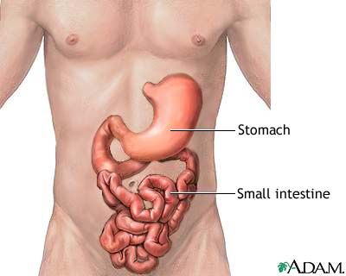
The Small Intestine
A long (≈6 m), narrow (≈3 cm) tube where most chemical digestion AND absorption of nutrients takes place

Slide 27
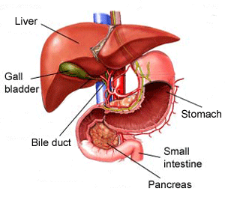
The Small Intestine
The Liver
Largest internal organ
Has many functions, however, for the digestive system, it produces bile.
Bile passes from liver to gallbladder, where it is stored until needed
Physically reduces fat particles into smaller droplets
*Like soap does with grease and oil

Slide 28
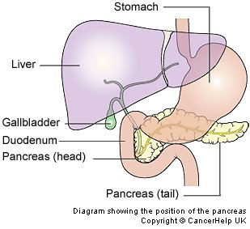
The Small Intestine
The Pancreas
Has many functions, however, for the digestive system it produces enzymes that break down starches, proteins, and fats

Slide 29
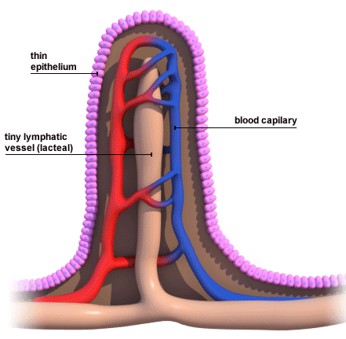
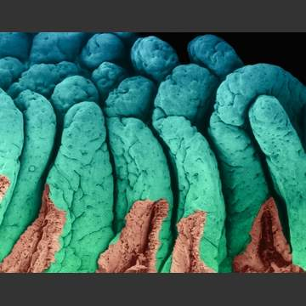
The Small Intestine
Absorption in the Small Intestine
The inner surface is bumpy with millions of small, fingerlike folds called villi
Each villus absorbs nutrient molecules directly into blood vessels
Villi increase the S.A. of the small intestine

Slide 30
The Large Intestine
Relatively short (≈1.5 m), wide tube
Material leaves that S.I. and enters the L.I. contains H₂O and undigested food
Water is absorbed into bloodstream
Bacteria feed on remaining material and make certain vitamins (e.g. vitamin K)

Slide 31
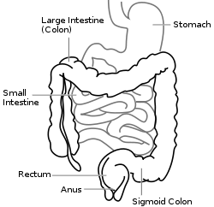
The Large Intestine
Remaining material is waste to be eliminated
Rectum
End of L.I. where waste is compressed into a solid
Anus
Muscular opening at end of rectum through which waste (fecal matter) passes

