Slide 1
Circulation – Chapter 16
Section 1 – The Body’s Transport System
Section 2 – Blood and Lymph
Section 3 – Cardiovascular Health

Slide 2
The body’s transport system
The Cardiovascular System
The Heart
Two Loops
Arteries
Capillaries
Veins
Blood Pressure

Slide 3
The Cardiovascular System
a.k.a “The Circulatory System” consists of: the heart, blood vessels, and blood
It’s main functions:
Delivering Needed Materials
Blood transports O₂ from lungs, and nutrients from intestines to cells of the body
Removing Waste Products
Blood transports wastes from cells, like CO₂ to lungs
Fighting Disease
Blood transports cells that attack disease-causing bacteria and viruses

Slide 4
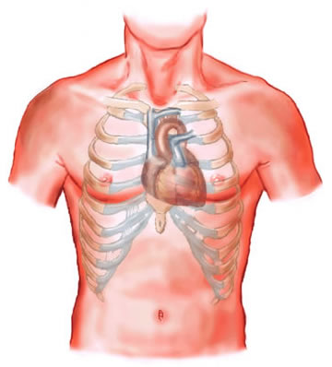
The Heart
Def: A fist-sized, hollow, muscular organ that pumps blood throughout the vessels of the cardiovascular system

Slide 5
The Heart
The Heart’s Structure
Septum – divides right side and left side
Each side has two chambers
Upper chambers – Atria
*Receives blood entering the heart
Pacemaker – cells in right atrium that signal heart muscle to contract
Lower chambers – Ventricles
*Pumps blood out of the heart
Valve – separates atria from ventricles, & prevents blood from flowing backward

Slide 6
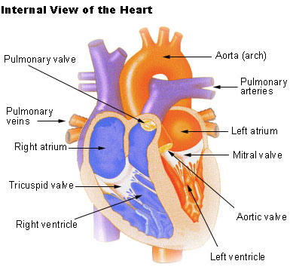
The Heart
The Heart’s Structure

Slide 7
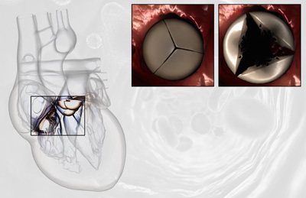
The Heart
The Heart’s Structure
Closed Valve
Open Valve

Slide 8
The Heart
How the Heart Works
Two main phases
First – Heart relaxes and fills with blood
Second – Heart muscle contracts and pumps blood outward

Slide 9
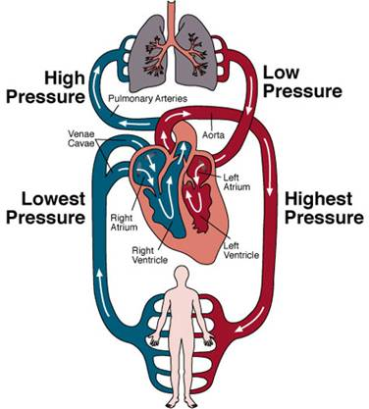
Two Loops
Pattern of Blood Flow
Two-loop pattern (Figure-eight) which crosses over at the heart

Slide 10
Two Loops
Loop One: To the Lungs and Back
Oxygen-poor, CO₂-filled blood (dark-red, “purple-ish”) flows into right atrium
Flows from right atrium to right ventricle
Right ventricle pumps blood to pulmonary arteries that lead to lungs

Slide 11
Two Loops
Loop One: To the Lungs and Back
At lungs, CO₂ is removed from blood and O₂ is added
Oxygen-rich (bright-red) blood travels through pulmonary veins back to heart into the left atrium

Slide 12
Two Loops
Loop Two: To the Body and Back
Flows from left atrium to left ventricle
Pumped from left ventricle into the aorta, the body’s largest artery
Blood in aorta branches off into blood vessels that lead to capillaries that reach every cell in the body

Slide 13
Two Loops
Loop Two: To the Body and Back
At the cells, O₂ moves into cells, CO₂ and other wastes move into blood
Oxygen-poor, CO₂-filled blood flows back to right atrium of heart

Slide 14
Arteries
Carry blood away from heart
Coronary arteries
Deliver oxygen-rich blood directly from left ventricle back to the heart itself
Artery Structure
Thick and muscular to handle pressure of blood flow
Pulse
Expansions & relaxation of artery as a spurt of blood passes through the vessel

Slide 15
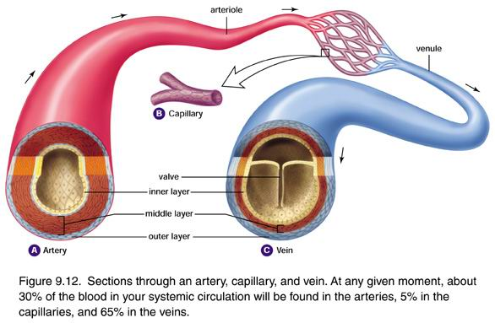
Capillaries
Microscopic blood vessels
One cell layer thick
Exchange materials between blood and cells by diffusion

Slide 16
Veins
Carry blood back to heart from cells & capillaries
Muscle-lined, BUT not as thick as walls of arteries
Large veins have valves to prevent backflow of blood

Slide 17
Blood Pressure
Caused by force of contracting ventricles
Measured by sphygmomanometer
Upper number = diastolic pressure
Caused by ventricle contraction
Lower number = systolic pressure
Caused by ventricle relaxation

Slide 18
Blood & Lymph
Blood
Blood Types
Lymphatic System

Slide 19
Blood
*Blood is a complex tissue that is made up of four different parts…
Plasma
Red Blood Cells
White Blood Cells
Platelets
≈55% of blood is plasma, while the remaining ≈45% is cells.

Slide 20
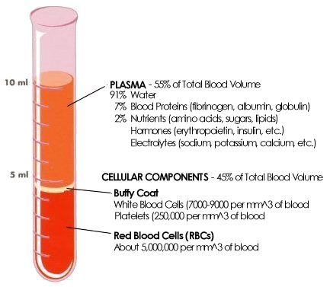
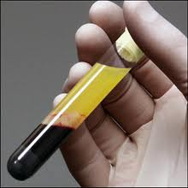
Blood

Slide 21
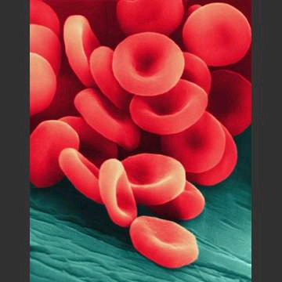
Blood
Plasma
Liquid part of blood (≈90% H₂O)
Dissolved nutrients (≈10%), including proteins which provide its yellowish color
Red Blood Cells
Flexible cells that pick up O₂ in lungs & deliver to body’s cells
Made up mostly of hemoglobin
Hemoglobin & plasma pick up CO₂ from body’s cells

Slide 22
Blood Types
Marker Molecules
Safe Transfusions
Rh Factor

Slide 23
Lymphatic System
Lymph
Lymph Nodes

Slide 24
Cardiovascular Health
Cardiovascular Diseases
Keeping Healthy

Slide 25
Cardiovascular Diseases
*Leading cause of death in the U.S.
Atherosclerosis
Condition in which a build-up of fatty materials (like cholesterol) causes artery walls to thicken
Results in reduced blood-flow in that artery

Slide 26
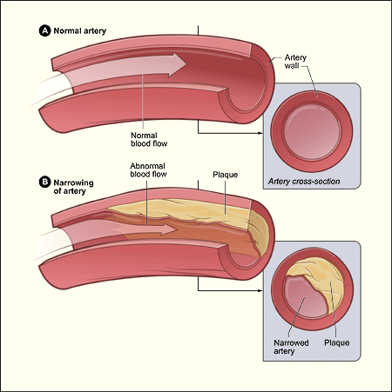
Cardiovascular Diseases

Slide 27
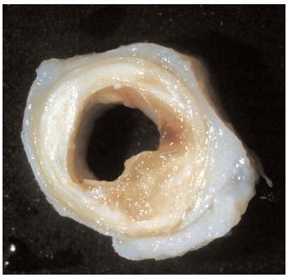
Cardiovascular Diseases
Heart Attack
Caused when atherosclerosis develops in the coronary arteries
Result is reduced blood flow to heart muscle cells
Causes cells to die

Slide 28
Cardiovascular Diseases
Hypertension
AKA – high blood pressure (typically > 140/90)
*Can be caused by atherosclerosis
Makes heart work harder to pump blood
Over time can damage heart and blood vessels
“Silent Killer”
Often no obvious symptoms until damage is severe

Slide 29
Keeping Healthy
Exercise & Diet
Limit foods high in cholesterol
Red meat, eggs, cheese
Limit foods high in saturated fats
Butter, whole milk, ice cream
Limit foods high in trans fat
Margarine, potato chips, doughnuts

Slide 30
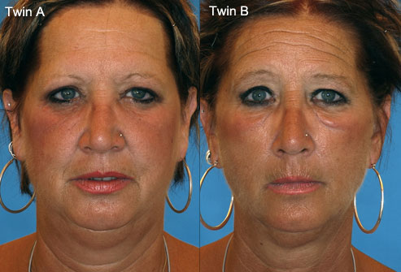
Keeping Healthy
Avoid Smoking
Increases likelihood of heart attack by more than 2x
Quitting decreases that probability

