Slide 1
Chapter 17 Respiration & Excretion
Section-1: The Respiratory System
Section-2: Smoking & Your Health
Section-3: The Excretory System

Slide 2
Section-1: The Respiratory System
Respiratory System Functions
The Path of Air
Gas Exchange
How You Breathe

Slide 3
Respiratory System Functions
The respiratory system moves O₂ from the outside environment into your body. It also removes CO₂ and water from the body
Recall… cellular respiration is the process by which cells use oxygen to release the energy from food molecules… CO₂ and water are wastes of this process
Breathing is the process by which air is moved into and out of the lungs

Slide 4
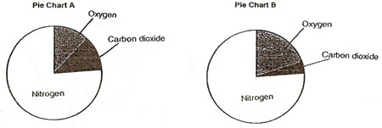
Respiratory System Functions
Inhaled vs. exhaled air

Slide 5
The Path of Air
Air passes through four structures as it moves from the outside environment to the lungs…
Nose
Pharynx
Trachea
Bronchi

Slide 6
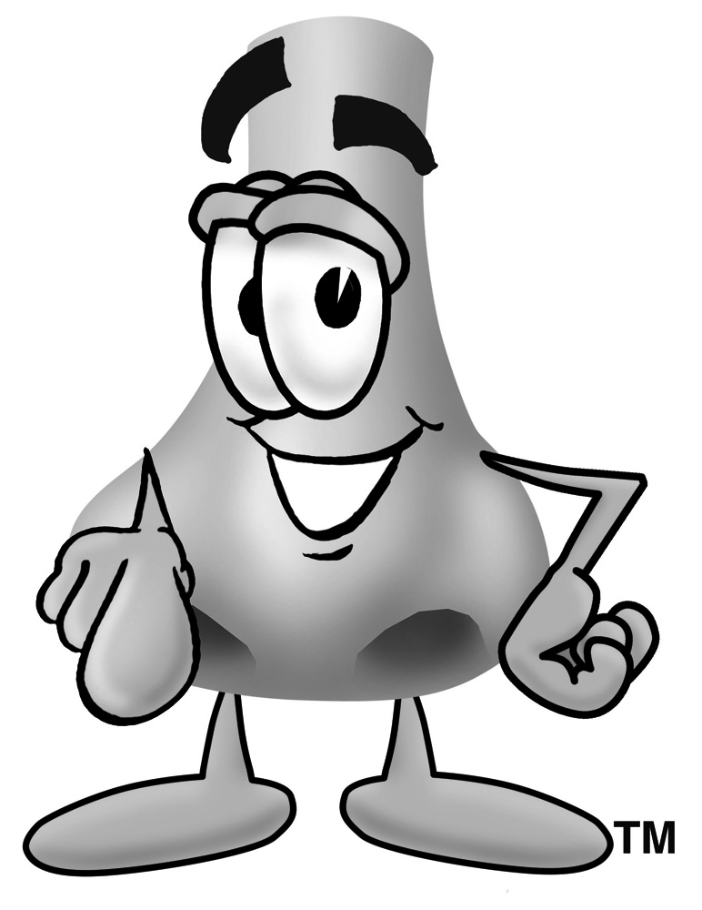
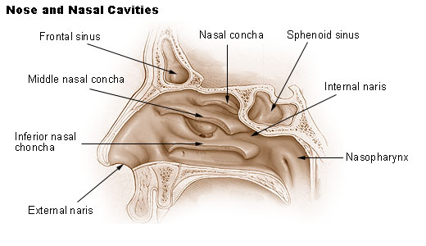
The Path of Air
The Nose
Mucus
Cilia
The “sneeze” (aka – the Navi Special)

Slide 7
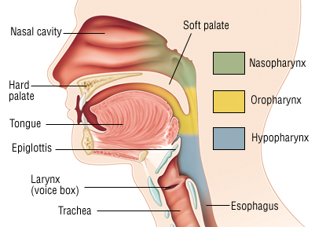
The Path of Air
The Pharynx (throat)
*Shared with digestive system (both mouth and nose connect to it)

Slide 8
The Path of Air
The Trachea (windpipe)
Mucus
Cilia
Coughing
Choking (usually prevented by epiglottis)

Slide 9
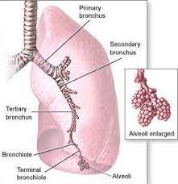
The Path of Air
The Bronchi & Lungs
Primary bronchus
Secondary bronchus
Tertiary bronchus
bronchioles
Alveoli (air sacs)
Each alveolus (singular) is surrounded by a capillary

Slide 10
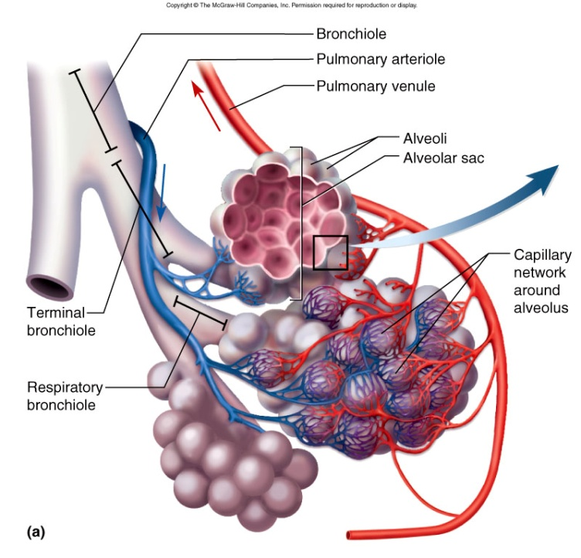
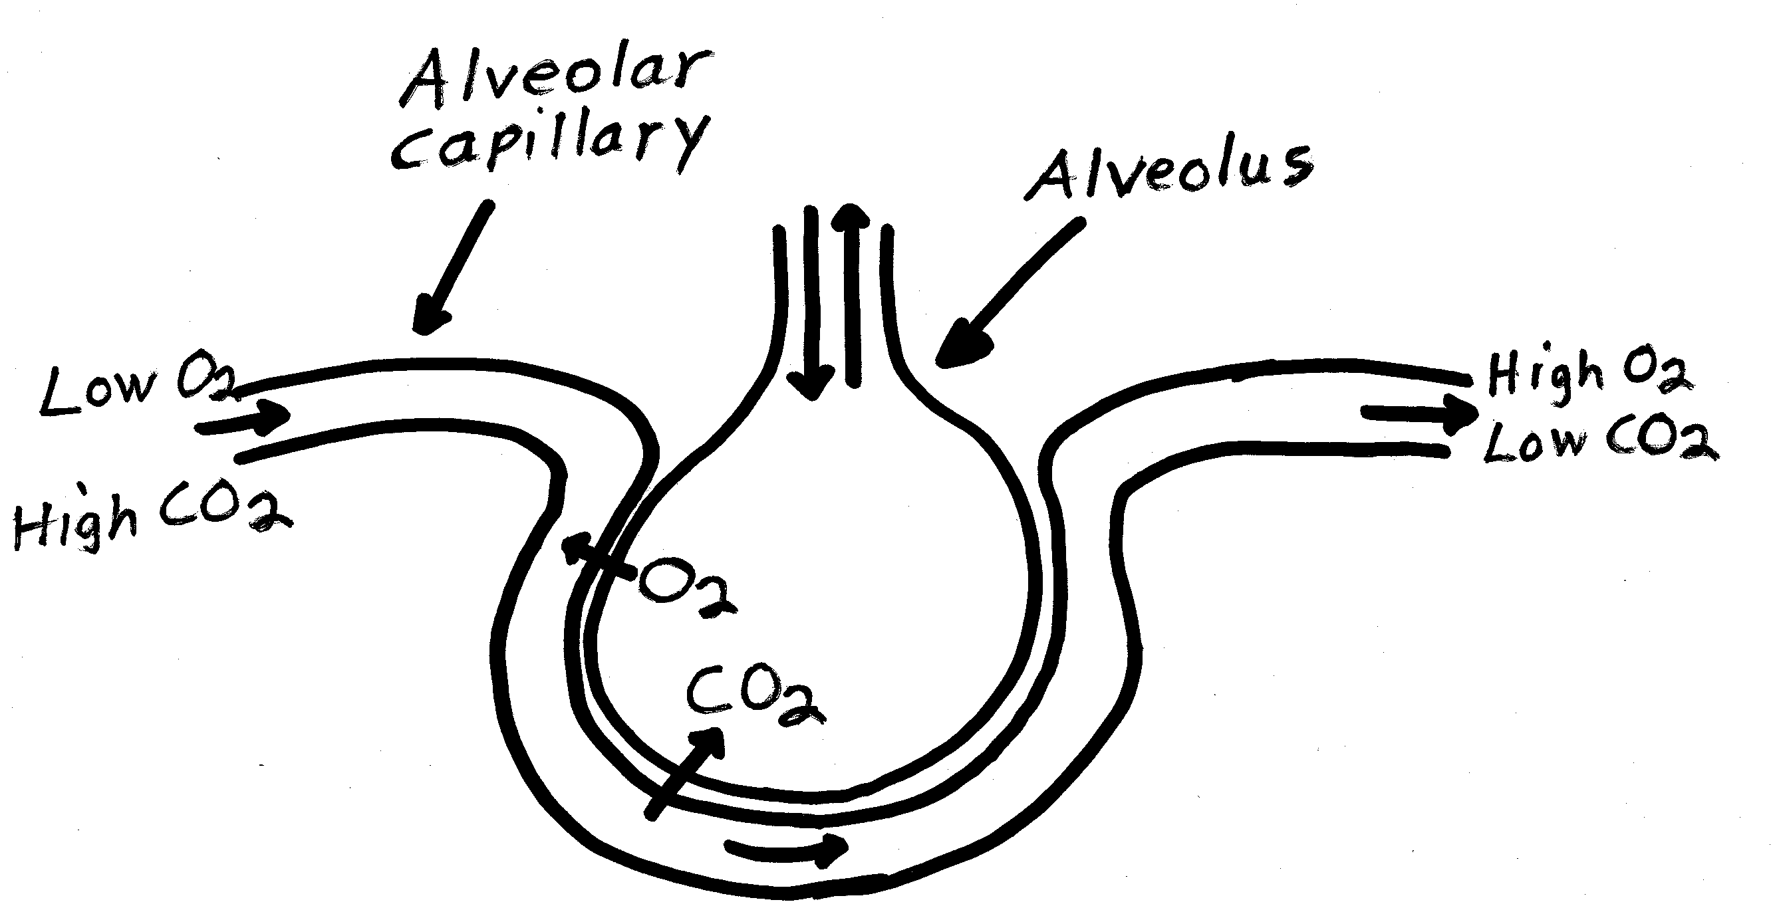
Gas Exchange
How Gas Exchange Occurs
After air enters an alveolus, O₂ passes through the wall of the alveolus and then through the capillary wall into the blood.
CO₂ and H₂O pass from the blood into the alveoli

Slide 11
Gas Exchange
Surface Area for Gas Exchange
≈ 300 million alveoli
If you spread them out on a flat surface, the area ≈ 70 m²
7 m
10 m

Slide 12
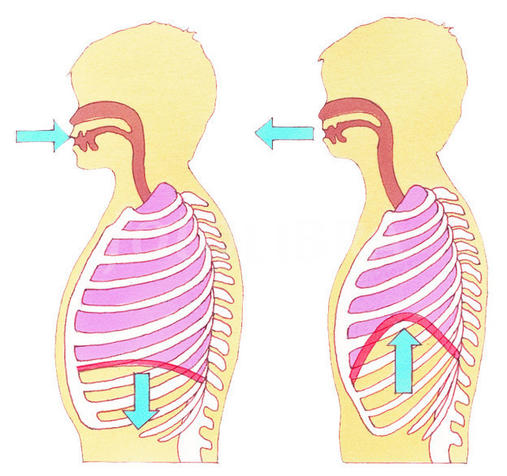
How You Breathe
Muscles for Breathing
On average, you breathe 20,000 times/day
Rate varies with body’s oxygen needs (physical activity, emotional state)
Contractions & relaxations of diaphragm forces air in/out of lungs

