Slide 1
Chapter 6 – Changes Over Time
Darwin’s Theory
Evidence of Evolution
The Fossil Record

Slide 2
Darwin’s Theory
Darwin’s Observations
Evolution
Natural Selection

Slide 3
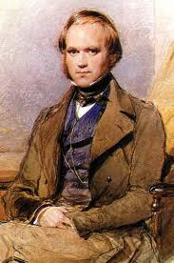
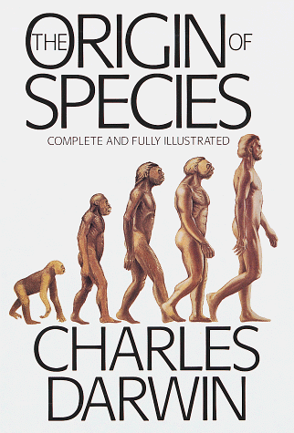
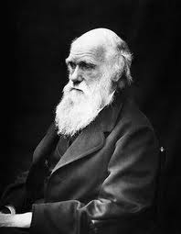
Darwin
Charles Darwin (1809 – 1882)
Authored On The Origin of Species (1859)
Father of theory of evolution by natural selection

Slide 4
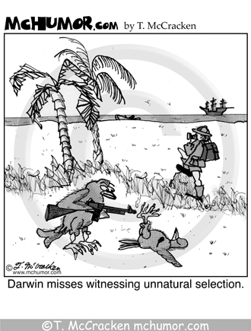
Darwin
The ongoing controversy, due mostly to religious resistance to the theory of evolution, has spurred a sometimes humorous reaction within pop culture

Slide 5
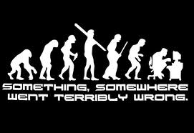
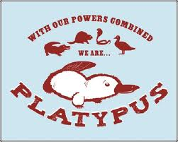
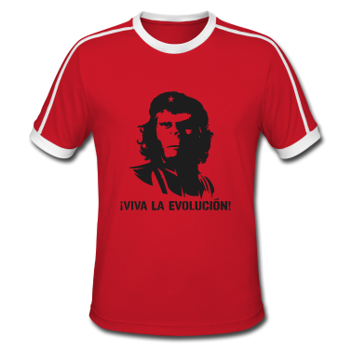
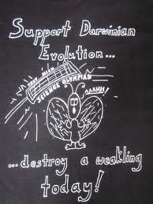
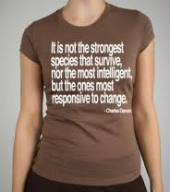

Slide 6
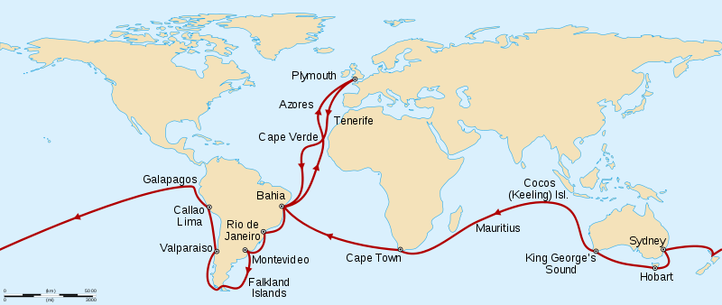
Darwin’s Observations
The voyage of the HMS Beagle (1831-1836)

Slide 7
Darwin’s Observations
Diversity
Voyage showed him that the variety of organisms was far more diverse than anyone had realized at the time
≈ 1.7 million species of organisms have been identified on Earth, and it is believed that there are millions more yet unidentified
Remember what a species is?

Slide 8
Darwin’s Observations
Fossils
Studied the fossils of animals that had died long ago, particularly bones
Noticed that the bones of some animals were much larger than those related animals alive today (e.g. the sloth).
He wondered what caused those animals from the past to disappear

Slide 9
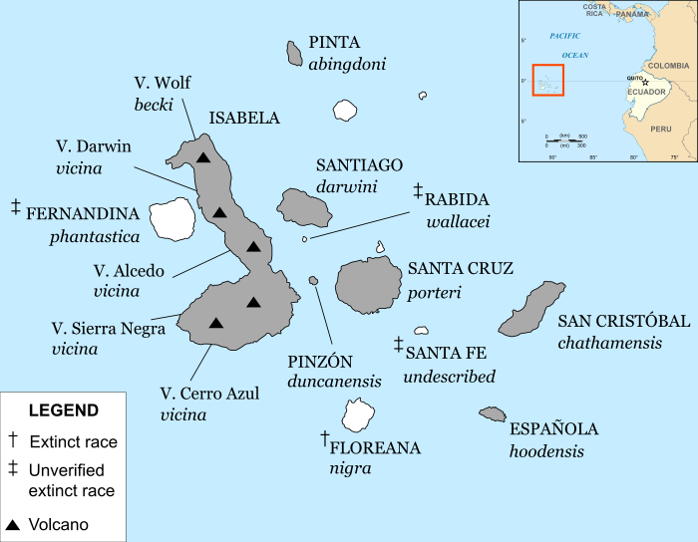
Galapagos Organisms

Slide 10
Galapagos Organisms
Comparisons to South American Organisms
Noticed many similarities between Galapagos and So. American birds and plants: He concluded that the birds and plants probably migrated to the islands with the wind
There were important differences however: Iguanas on the islands have large claws for clinging to rocks and feeding on seaweed. They also have thicker tails for swimming. Iguanas on the mainland have smaller claws for climbing trees and feeding on leaves

Slide 11
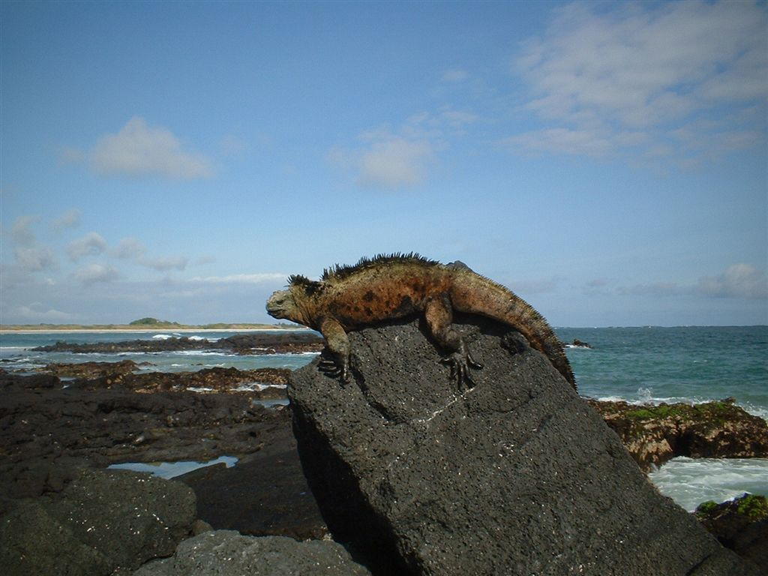
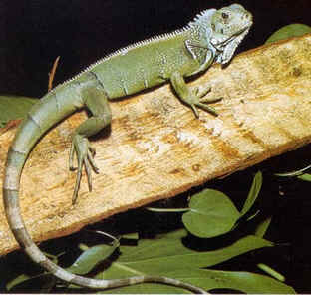
Galapagos Organisms
Comparisons to South American Organisms
Galapagos Iguana Mainland Iguana

Slide 12
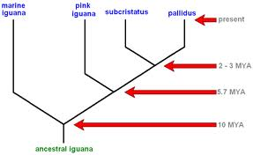
Galapagos Organisms
Comparisons to South American Organisms
Iguana family tree

Slide 13
Galapagos Organisms
Comparisons Among the Islands
Again… the same organisms lived on all of the islands, however, there were significant differences among them from island to island
You can tell which island a Galapagos tortoise comes from just by the appearance of its shell
Galapagos finches differ from each other as well as from mainland So. American finches

Slide 14
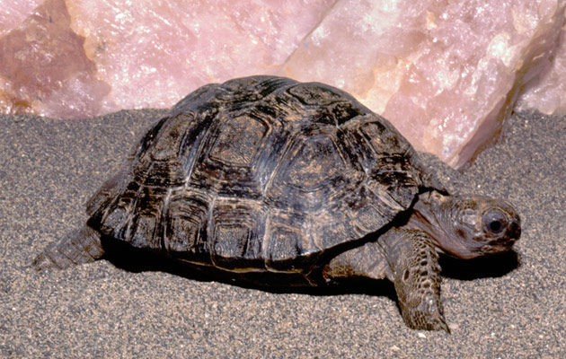
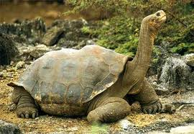
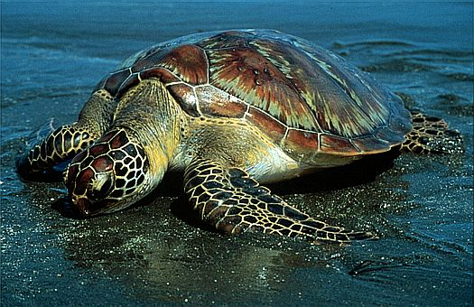
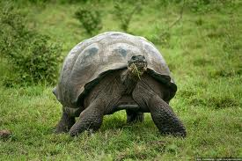
Galapagos Organisms

Slide 15
Galapagos Organisms
Adaptations
A trait that helps an organism survive and reproduce
Ex: beak shape of birds
Aids in feeding
Finches with long, narrow beaks feed on insects, while finches with strong, thick beaks feed on seeds
Ex: poisonous plants
Aids in avoiding being eaten
Ex: flower color
Aids in reproduction since bright colors attract pollinating insects

Slide 16
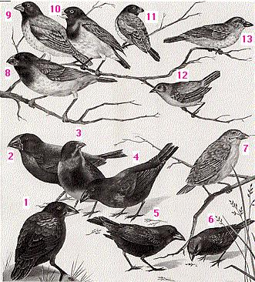
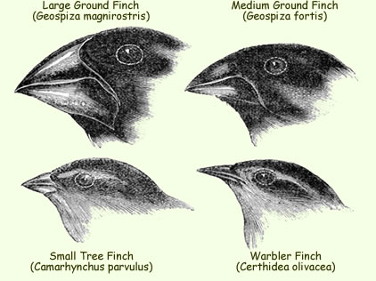
Galapagos Organisms
Which finches are better adapted to eating seeds? …Why?

Slide 17
Evolution
Darwin’s Reasoning
The plants and animals found on the Galapagos Islands came from mainland So. America
These organisms faced very different environmental conditions than those on the mainland
Hypothesized that these species gradually changed over thousands of generations and became better adapted to the Galapagos environment: thus, they evolved!
He did not know how these changes occurred

Slide 18
Evolution
Selective Breeding
Another term for artificial selection
Had been used to produce variety of dog breeds with desirable traits, as well as with domestic cattle, sheep, and crops
Darwin thought a similar process might happen in nature, but wasn’t sure how certain traits were selected

Slide 19
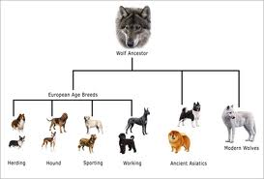
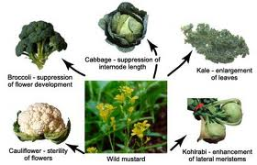
Evolution
Selective Breeding

Slide 20
Natural Selection
In 1858, Darwin proposed the mechanism that causes organisms to naturally evolve in his book, On The Origin of Species
Natural Selection
The process by which individuals that are better adapted to their environment are more likely to survive and reproduce than others of the same species
Natural selection is affected by overproduction, variations, and competition

Slide 21
Natural Selection
Overproduction
MOST species produce far more offspring that can possibly survive due to limited resources
Variations
A variation is any difference between individual members of the same species
Competition
Members of a species must compete with each other to survive due to limited resources (food, shelter, etc.)
Rarely involves direct conflict

Slide 22
Natural Selection
Selection
In a way, the environment “selects” those organisms with helpful traits to become the parents of the next generation.
Over long time periods, natural selection leads to change.
Helpful variations accumulate in a species while unfavorable ones can disappear altogether

Slide 23
Natural Selection
Environmental Change
Can affect an organism’s ability to survive, therefore, can lead to selection
Some offspring may be born with traits that increase their chances of survival under the new conditions: these organisms live to reproduce and pass on those traits, while others die

Slide 24
Natural Selection
Genes and Natural Selection
Genetic mutations and mixing alleles during meiosis can cause variations in living things.
Those inherited traits can be acted upon by natural selection

Slide 25
Section 1 Assessment
1.a. Darwin observed (1) the diversity of living things, (2) fossils, and (3) the characteristics of organisms on the Galapagos Islands.
1.b. So. American iguanas have small claws for climbing trees and eating leaves, while Galapagos iguanas have large, strong claws to cling to rocks while eating seaweed.
1.c. An adaptation is a trait that helps an organism survive and reproduce. The claws of both types of iguanas are adaptations in that they both are beneficial in allowing the iguanas to safely reach their primary food source.
2.a. Galapagos species have different adaptations than similar So. American species because the environment of the Galapagos is different than the mainland.

Slide 26
Section 1 Assessment
2.b. Selective breeding is where humans select the desirable traits species should have by controlled breeding, and the results yield changes in the species over several generations. This supported Darwin’s hypothesis in that natural processes could also select certain traits causing species to change over time.
3.a. A variation is any difference between individuals of the same species. Natural selection is the process by which individuals that are better adapted to their environment are more likely to survive and reproduce than other members of the same species.

Slide 27
Section 1 Assessment
3.b. Variation results in differences between members of a species. Natural selection allows only those individuals with traits that are well adapted to their environment to survive and reproduce, thus passing those desirable traits on to their offspring. Over time, those desirable traits can accumulate causing that species to change.

