Slide 1
Chapter 6 – Changes Over Time
Darwin’s Theory
Evidence of Evolution
The Fossil Record

Slide 2
The Fossil Record
How Do Fossil’s Form?
Determining a Fossil’s Age
What Do Fossil’s Reveal?
Unanswered Questions

Slide 3
How Do Fossils Form?
The formation of fossils is rare, and when they do, it is almost always just the hard parts that form fossils (e.g. Bones and shells). Most fossils from when organisms that die become buried in sediments.
Petrified Fossils
minerals dissolved in water can soak into the remains gradually changing them into rock
Ex: petrified forest

Slide 4
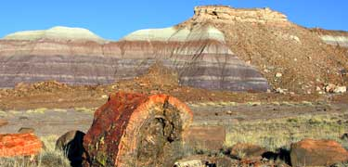
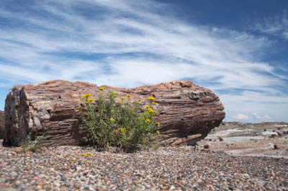
How Do Fossils Form?
Petrified Forest National Park, Petrified Forest, AZ
Website for the Petrified Forest in Calistoga, CA
http://www.petrifiedforest.org/index.html

Slide 5
How Do Fossils Form?
Molds and Casts
When some organisms die and become buried in sediments, their shells or bones eventually dissolve leaving an empty space behind, called a mold.
If a mold becomes filled with hardened minerals, it forms a cast. A cast is a copy of the shape of the organism that made the mold.
Preserved Remains
Some environments are better at preserving the actual parts of the organism. For example, entire wooly mammoths have been found preserved in ice.

Slide 6
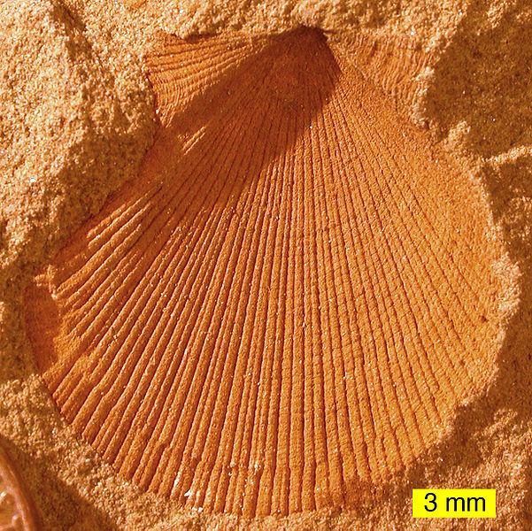
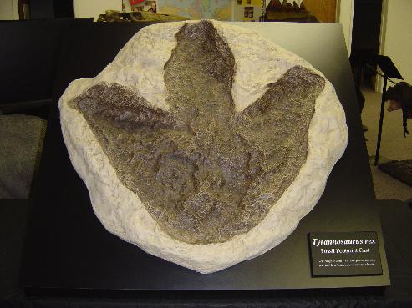
How Do Fossils Form?
Molds

Slide 7
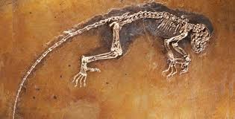
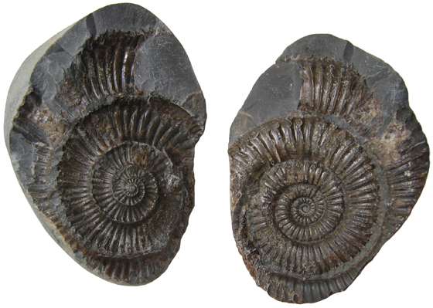
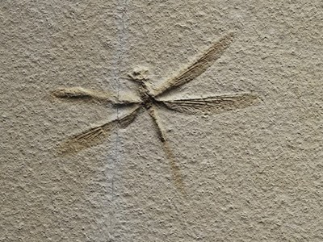
How Do Fossils Form?
Casts

Slide 8
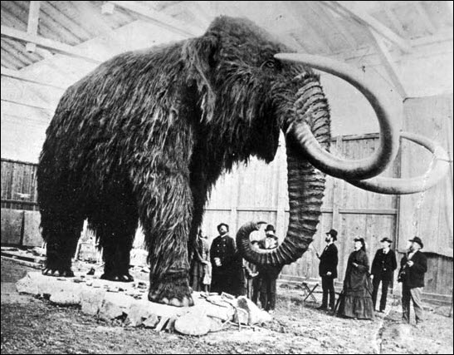
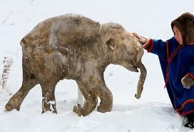
How Do Fossils Form?
Preserved Remains

Slide 9
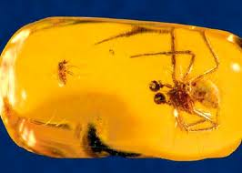
How Do Fossils Form?
Preserved Remains
Polar environments - freezing
Arid environments – mummification
Tar pits – La Brea, CA
Peat bogs – northern Europe
Amber – petrified tree sap (“Jurassic Park”)

Slide 10
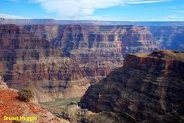
Determining a Fossil’s Age
There are TWO methods used to date fossils:
Relative Dating
Deeper rock layers were formed first, while layers closer to the surface were formed more recently.
Thus fossils found in deeper rock layers are older than those found in shallower layers
The Grand Canyon

Slide 11
Determining a Fossil’s Age
There are TWO methods used to date fossils:
Radioactive Dating
If fossils are found near rocks containing radioactive elements, scientists can use the predictable way these unstable elements decay to determine the age of the rocks

Slide 12
What Do Fossils Reveal?
Extinct Organisms
Almost everything learned about extinct species has been learned by studying fossils
The Geologic Time Scale
Like a “calendar” of life on Earth for the past 4.6 billion years
Based upon fossil record, relative, and radioactive dating methods

Slide 13
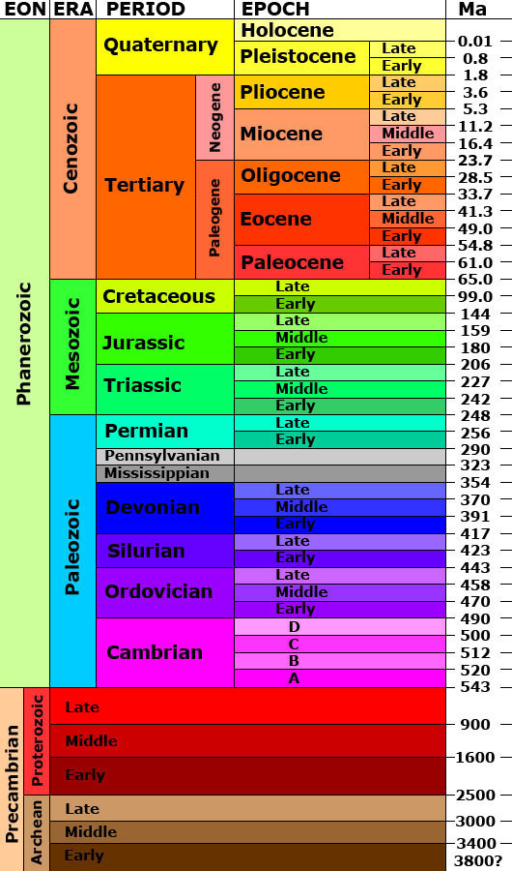
A Geologic Time Scale
-Eons
-Eras
-Periods
-Epochs
-Ages

Slide 14
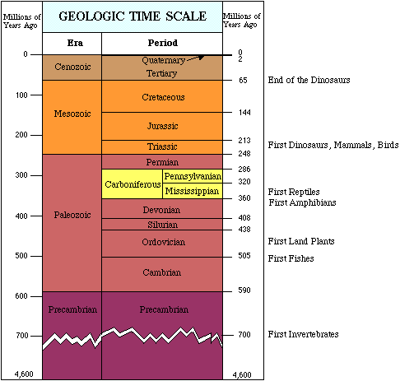

Slide 15
Unanswered Questions
There are TWO main unanswered questions left by the fossil record:
What caused mass extinctions?
What is the rate at which evolution occurs?

Slide 16
Unanswered Questions
Mass Extinctions
Def: Many species become extinct at the same time
There have been a number of mass extinctions over the course of Earth’s history
Scientists are unsure about the causes of these events, BUT, were most likely brought about by sudden environmental changes
Could’ve been caused by:
Large asteroid impact
Massive volcanic eruption(s)

Slide 17
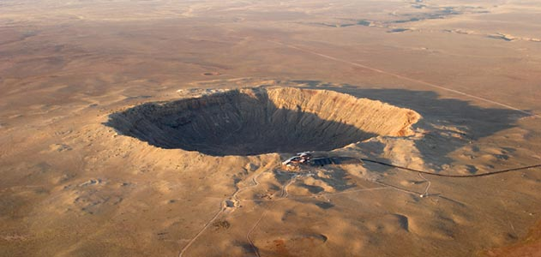
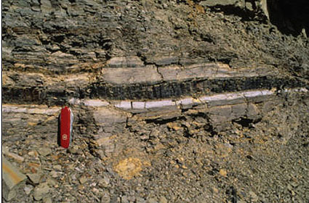
Unanswered Questions
Meteor crater, AZ:
Formed from asteroid impact approx. 50,000 years ago
“K-T boundary”: rock layer found all over Earth. Evidence of massive asteroid impact

Slide 18
Unanswered Questions
Gradualism
Theory that states evolution occurs slow but steady
Problems with gradualism:
Fossil record does not include intermediate forms between an organism and its descendants
Some fossils show long periods with little to no change, and then suddenly, noticeably different fossils appear
Punctuated Equilibria
Theory states that some species will evolve rapidly over short time intervals. Those periods of rapid change are separated by long periods of little to no change.

