Slide 1
Dog breeds: Their roles & temperaments

Slide 2
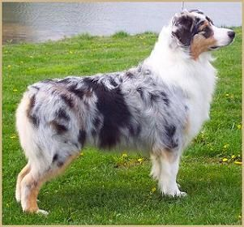
Australian shepherd

Slide 3
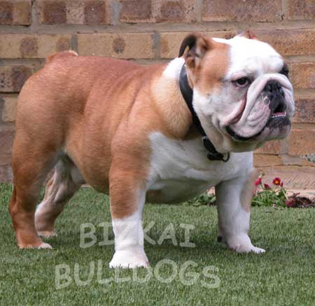
bulldog

Slide 4
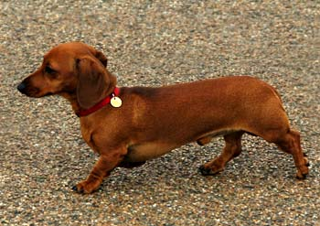
dachsund

Slide 5
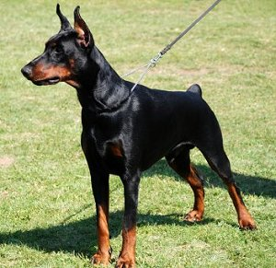
dobermAN PINSCHER

Slide 6
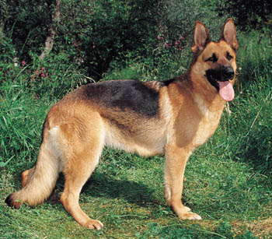
GERMAN SHEPHERD

Slide 7
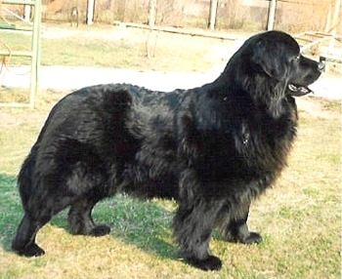
NEWFOUNDLAND

Slide 8
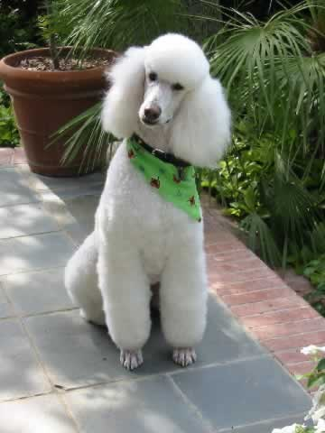
POODLE

Slide 9
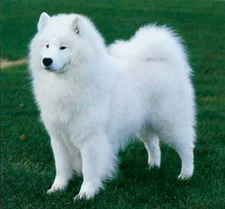
SAMOYED

Slide 10
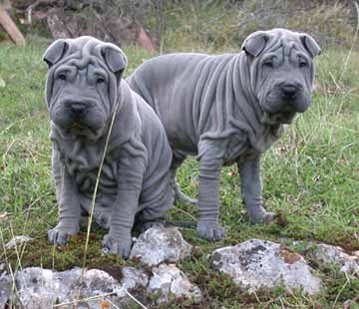
SHAR-PEI

Slide 11
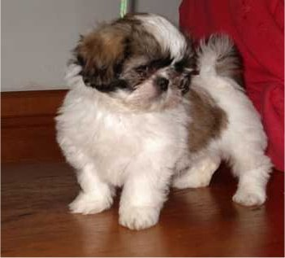
SHIH TZU

