Slide 1
Introduction to Life Science
Chapter 1

Slide 2
Section 1 – What is Science?
Science:
A way of learning about and figuring out the truth of the natural world
Skills used by scientists:
Observing
Inferring
Predicting
Classifying
Making models

Slide 3
Observing
Using one or more of your senses to gather information (facts).
Observations can be:
“Quantitative”
Observation that involves a count or amount of something
Ex: There are 22 emails in my inbox
“Qualitative”
Observation that involves a description that can’t be expressed with numbers
Ex: The NY-Giants uniforms are blue and white

Slide 4
Inferring
Attempting to explain or interpret an observation
Often involves guessing, BUT not wild guessing

Slide 5
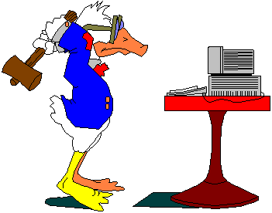
Make some observations about the picture below. Then make some inferences to explain it.

Slide 6
Predicting
Closely related to “inference”
Inference attempts to explain what has happened or is currently happening
Prediction is an attempt to forecast what will happen based upon observations or past experience

Slide 7
Classifying
Grouping information that is alike in some way
Ex: How are your clothes classified in your room?

Slide 8
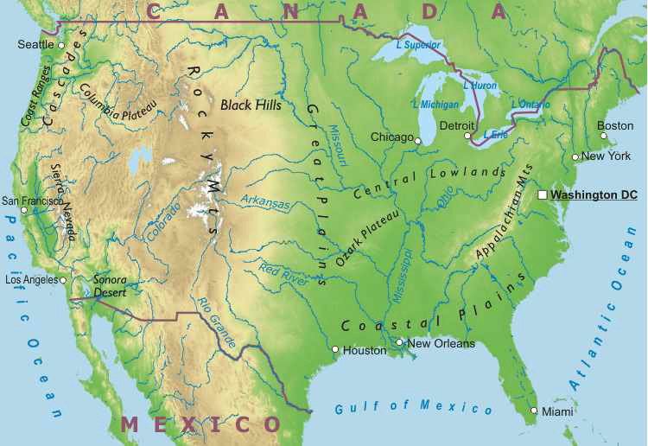
Making Models
Models help to simplify things that are complex or difficult to understand
Examples –
Globes & maps
Electron-dot diagrams
Computer simulations
Oxygen atom

Slide 9
Working in Life Science
Some careers in the life sciences are…
Botanist
Park ranger
Marine biologist
Forestry technician
Health-care workers
Medical doctors
Nurses
Physical therapists

Slide 10
Section 2 – Scientific Inquiry
The Scientific Process
Scientific Attitudes

Slide 11
The Scientific Process
Scientific inquiry refers to the many ways in which scientists study the natural world and propose explanations based upon the evidence they gather
It usually begins with a problem to solve or a question that needs to be answered
A good question cannot be answered by simple “YES” or “NO”

Slide 12
The Scientific Process
The next step is to develop a hypothesis
A possible explanation for an observed phenomenon
An educated guess, or prediction, as to the answer of a question
It must be testable!
Gather evidence to either support or reject a hypothesis

Slide 13
The Scientific Process
Design an experiment
Tests a hypothesis
All factors that can change in an experiment are called variables.
Manipulated (aka independent) variable is the variable that is purposely changed
Responding (aka dependent) variable is the factor that may change in response to the manipulated variable

Slide 14
The Scientific Process
Controlled experiment
Only one variable is manipulated at a time, so we know that any change in the responding variable is due to that one factor!
All other variables must be kept exactly the same
Variable kept the same are often called constants

Slide 15
The Scientific Process
Collect and interpret information (data)
Data are facts, figures, and other info gathered by observations
Organized into tables and graphs to aid understanding
Draw conclusions as to what the results of the experiment really mean
Communicate results and interpretations with others through writing and speaking

