Slide 1
Genetics: The Science of Heredity
Text chapter 4
Mendel’s work
Probability & heredity
The cell & inheritance
The dna connection

Slide 2
Mendel’s Work
Chapter 4, Section 1

Slide 3
Mendel’s Experiments
Vocabulary
Heredity
The passing of physical characteristics from parents to offspring
Trait
Each different form of an organism’s specific physical characteristics
Ex: eye-color traits…blue-eyed, brown-eyed, hazel-eyed, etc.
Genetics
Scientific study of heredity

Slide 4
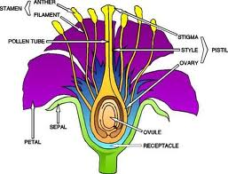
Mendel’s Experiments
Mendel’s Pea Plant Experiments (background)
Pea plants reproduce sexually
The pistil produces female sex cells, or eggs
The stamen produces pollen, which contains males sex cells, or sperm

Slide 5
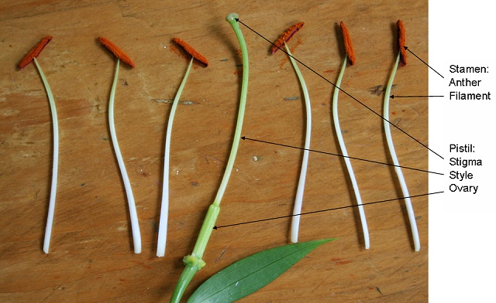
Mendel’s Experiments
Mendel’s Pea Plant Experiments (background)
Fertilization occurs when egg and sperm join together
Before fertilization, pollination must occur
Pollination is the process by which pollen is transferred from the stamen of plant to the pistil.
*Pea plants are normally self-pollinating, meaning that pollen from a flower lands on the pistil of the same flower

Slide 6
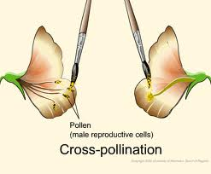
Mendel’s Experiments
Mendel’s Pea Plant Experiments (background)
Developed a method of preventing self-pollination, and instead cross-pollinated (or “crossed” for short) different pea plants
*Notice what’s missing from this flower?
*What about from this flower?

Slide 7
Mendel’s Experiments
Mendel’s Pea Plant Experiments
Crossed “pure-bred” tall plants with pure-bred short plants, called the “P generation” (parents)
In the first generation of offspring, called the “F1 generation” (first filial), only tall plants appeared
He then allowed the F1 plants to self-pollinate and produce a second generation of offspring
In the second generation of offspring, called the “F2 generation” (second filial), both tall plants and short plants appeared
Approx. ¾ of the plants were tall, while approx. ¼ were short

Slide 8
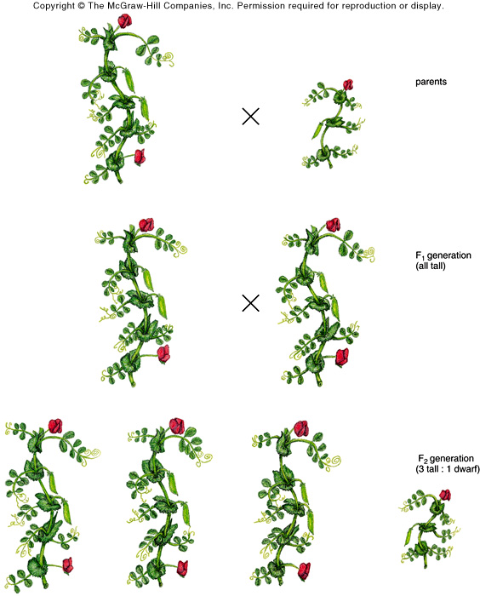
Mendel’s Pea Plant Experiments
P
generation
F1
generation
F2
generation

Slide 9
Mendel’s Experiments
Mendel’s Pea Plant Experiments
Crossed pea plants with other contrasting traits
In all of the cross-pollinations…
Only one form of the trait appeared in the F1 generation
In the F2 generation, the “lost” form of the trait always reappeared in approx. ¼ of the plants

Slide 10
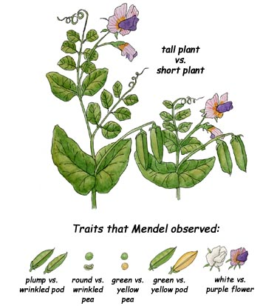
Mendel’s Pea Plant Experiments
Some of the other contrasting traits that Mendel experimented with…

Slide 11
Dominant & Recessive Alleles
Mendel came to the following conclusions…
Individual genetic factors determine the inherited traits in pea plants
The factors that determine each trait exist in pairs:
The female parent contributes one factor, while the male parent contributes the other
One factor in a pair can hide, or dominate, the other factor
E.g. the tallness factor hid the shortness factor

Slide 12
Dominant & Recessive Alleles
Gene
Factors that control a trait
Segment, or portion of DNA molecule
Allele
Different forms of a gene: e.g. the gene for stem height in peas has one allele for tall stems, and another for short stems
Dominant Allele
Trait always appears in the organism when the allele is present
Recessive Allele
Hidden when the dominant allele is present. The trait only appears in an organism when the dominant allele is missing.

Slide 13
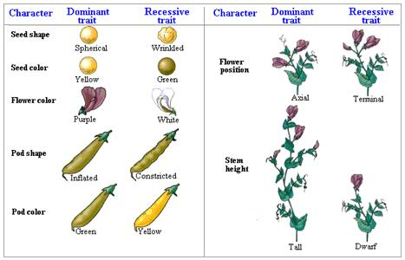
Mendel’s Experiments
Mendel identified a number of specific dominant and recessive traits determined by alleles in the genes of pea plants

Slide 14
Mendel’s Experiments
Pure
Organism that has the same two alleles for a trait (a.k.a – homozygous)
Pure tall pea plants have two tall alleles (TT)
Pure short peas have two short alleles (tt)
Hybrid
Organism that has two different alleles for the same trait (a.k.a. – heterzygous)
Hybrid tall plants have one tall allele and one short allele (Tt)
Hybrid tall plants are still tall, because the tall allele is dominant!

